Slide 1
Detonation:
Initiation, Propagation and Failure
Joseph E Shepherd
Aeronautics and Mechanical Engineering
California Institute of Technology
Pasadena, CA 91125 USA
Purdue University October 4, 2023

Slide 2
Today’s Talk
Focus: The seemingly “simple” situation of detonations in homogeneous, premixed gases.
What are the characteristics of “simple” detonations?
Examples
Initiation and stabilization of detonations on high-speed projectiles.
Initiation of propagating detonations by strong decaying shock waves.
Initiation and failure of detonation waves propagating through area changes.
Goal: Explain the role of unsteadiness and spatial gradients within and behind the reaction zone region in these situations.
Theme: The unifying notion is the existence of critical levels of unsteadiness and gradients in flow properties that define the boundaries between flow regimes.

Slide 3

Preliminaries
"Research is frequently the process of moving old bones from one graveyard to another"
- J. Frank Dobie

Slide 4
What is a Detonation Wave?
  A supersonic combustion wave characterized by a unique coupling between a shock front and a zone of chemical energy release referred to as the “reaction zone.”
Not just shock-initiated combustion!

Slide 5
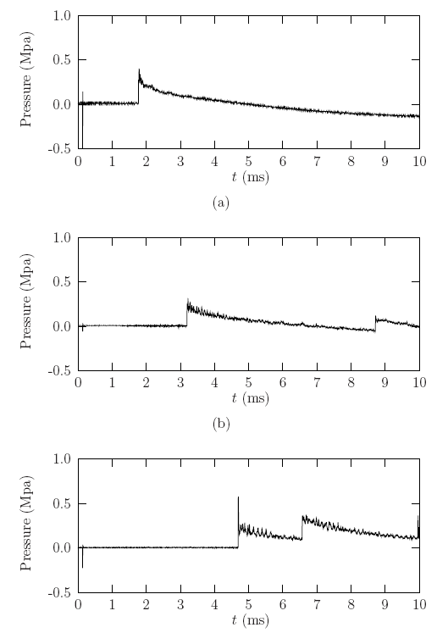
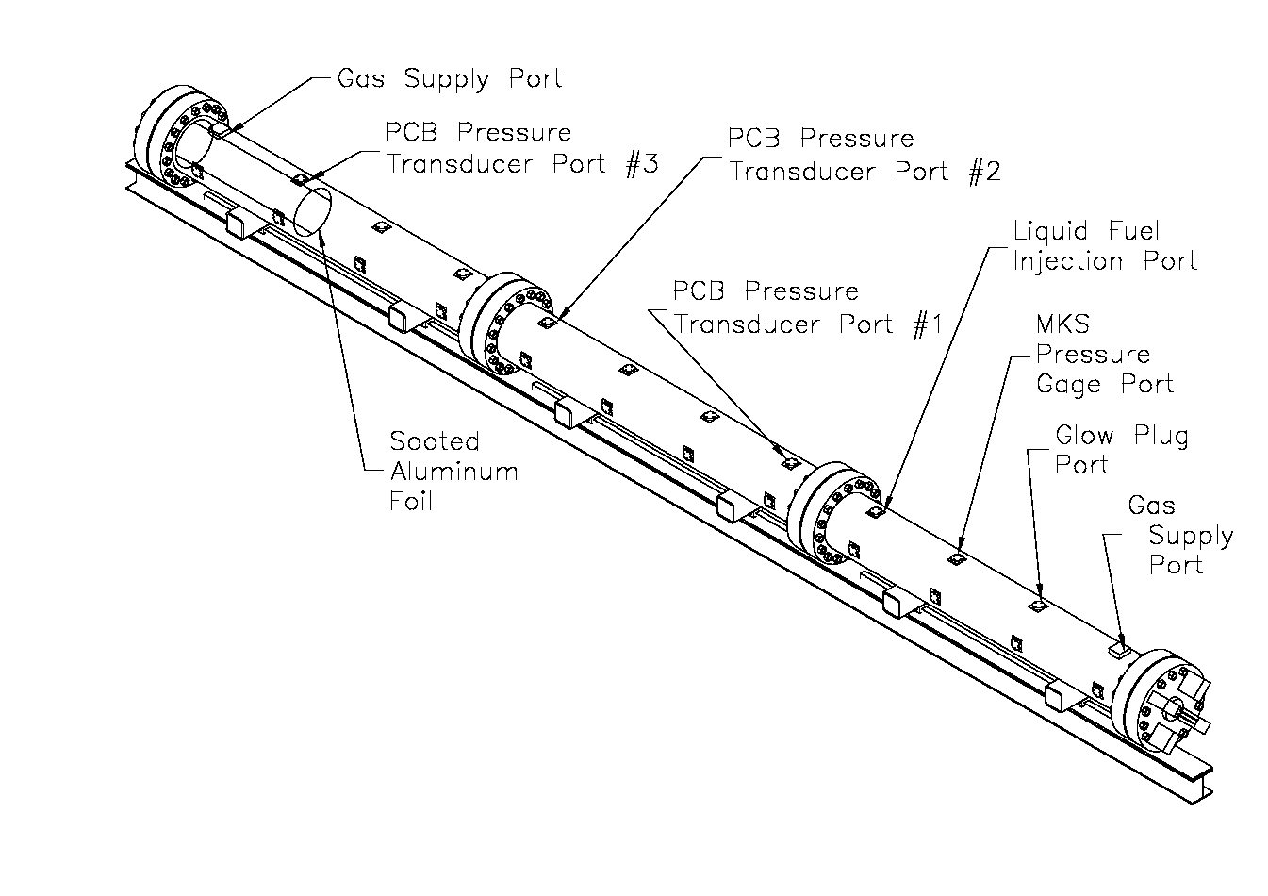
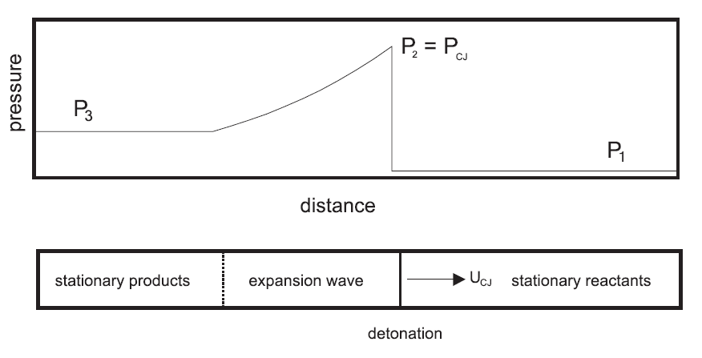
Detonations are pressure waves
Beltman and Shepherd 2002
Notes:
W.M. Beltman and J.E. Shepherd.
Linear elastic response of tubes to internal detonation loading.
Journal of Sound and Vibration, 252(4):617-655, 2002.

Slide 6
Detonations Are Driven by Hot Combustion Product Expansion
Fuel + Oxidizer → Products
CH₄ + O₂ → CO₂ + 2H₂O
Volume expansion pushes shock wave
Chemical reaction
Shock front
u
D
u = 0
expansion
u = 0

Slide 7

Donald Chapman
Ehrile Jouguet
1889-1905

Slide 8
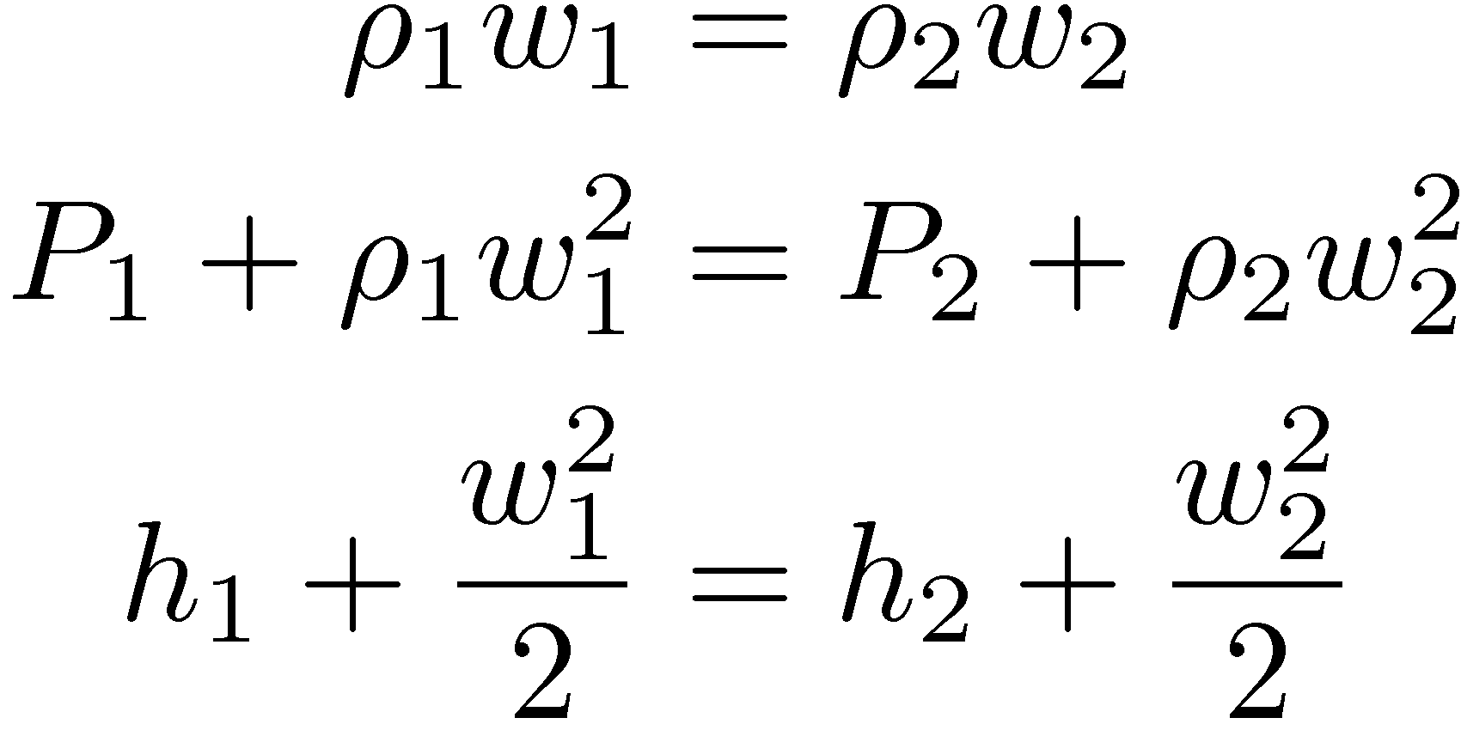
Donald Chapman
Ehrile Jouguet

Slide 9
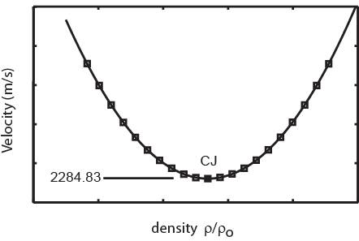
Donald Chapman
Ehrile Jouguet
or
Sonic flow relative to wave

Slide 10
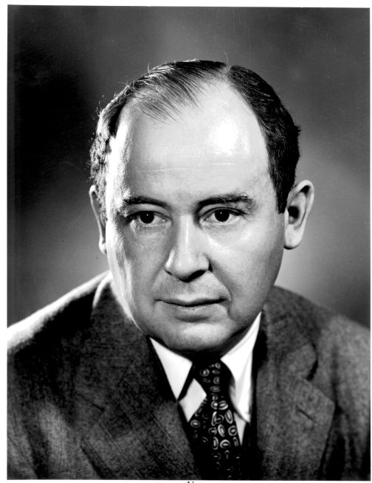
”ZND’’ 1940-43
Yakov Zel’dovich
John von Neumann
Werner Döring
shock
products
reactants
Temperature
products
Cold fuel/oxidizer mixture
radicals
Sonic
plane
induction zone
Energy release

Slide 11
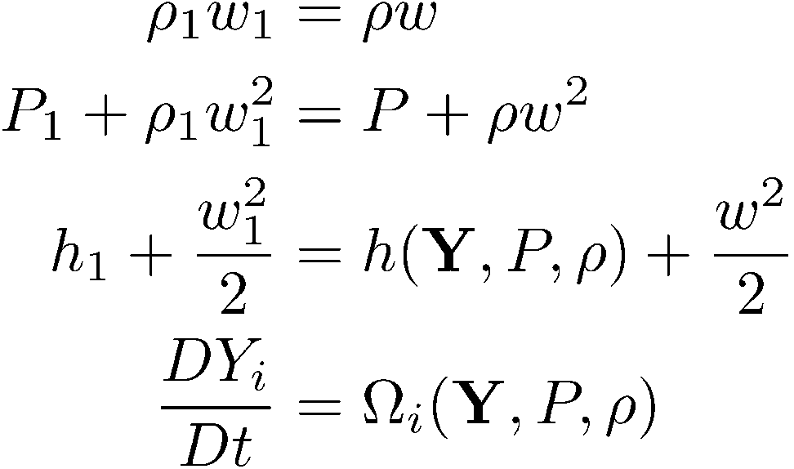
”ZND’’ 1940-43
P
vN
CJ
1
v

Slide 12
”ZND’’ 1940-43
thermicity

Slide 13
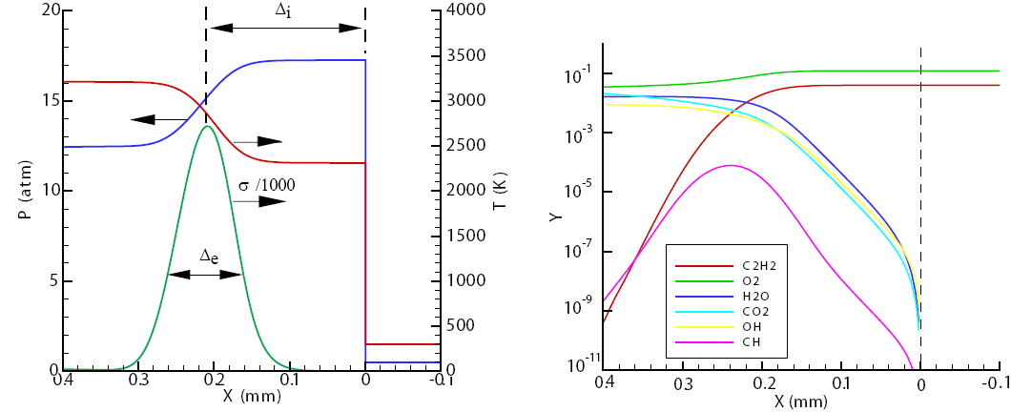
”ZND’’ 1940-43

Slide 14
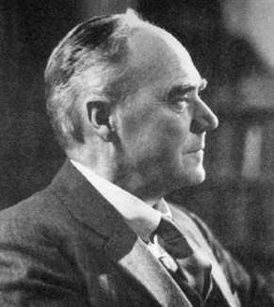
G. I. Taylor
particle path
t
3
Stationary region
2
1
0
X

Slide 15
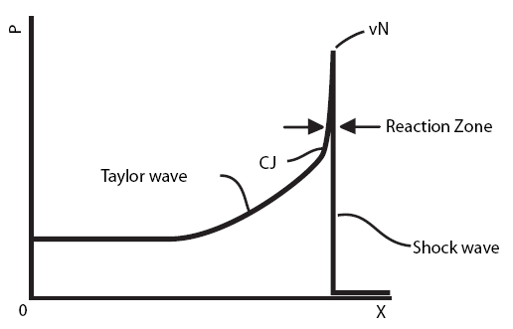
Bach et al 1969

Slide 16
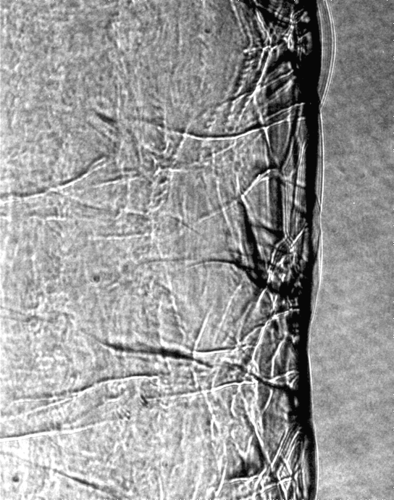

Slide 17


Slide 18
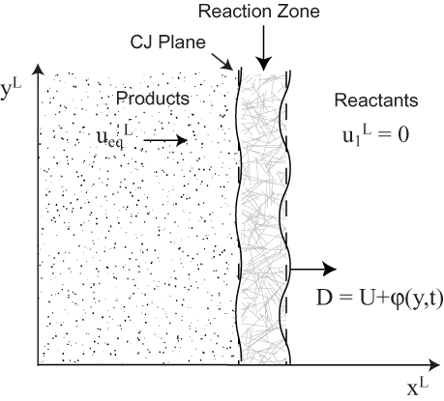
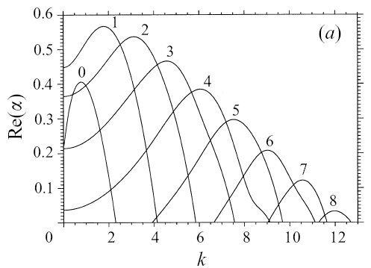
Erpenbeck 1964, Lee and Stewart 1990, Short, Sharpe, Kasimov, Tumin, …

Slide 19
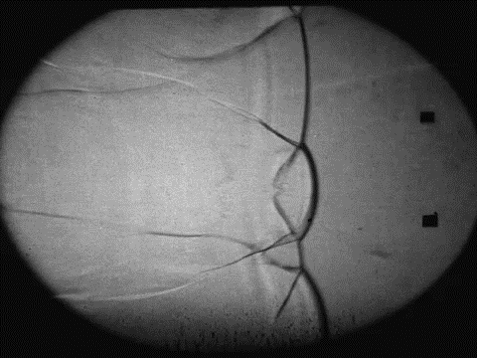
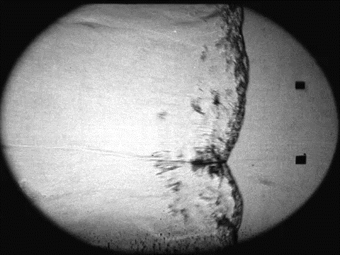
2H₂-O₂-85%Ar
P_{o}=20 kPa
C₃H₈-5O₂-60%N₂
P_{o}=20 kPa
scale:4mm
Austin 2003
Notes:
Movies obtained by Joanna Austin in Explosion Dynamics Laboratory, Caltech PASADENA, CA.
Joanna Austin. The Role of Instability in Gaseous Detonation.
PhD thesis, California Institute of Technology, Pasadena, California, June 2003.

Slide 20
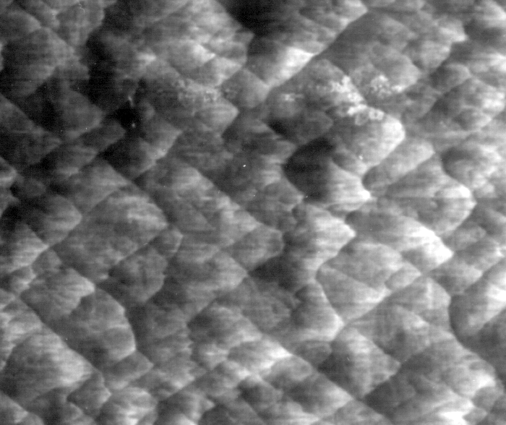
Soot foil:
Cell width measurements
λ
M. Kaneshige and J.E. Shepherd. Detonation database. Technical Report FM97-8,
Graduate Aeronautical Laboratories, California Institute of Technology, July 1997
Notes:
See R. Akbar, M. Kaneshige, E. Schultz, and J.E. Shepherd.
Detonations in H -N O-CH -NH -O -N mixtures.
Technical Report FM97-3, GALCIT, July 1997.
And
JM Austin and JE Shepherd.
Detonation in hydrocarbon fuel blends.
Combustion and Flame, 132(1-2):73-90, 2003.
And
J.-P. Hébral and J. E. Shepherd.
User guide for detonation cell size measurement using photoshop and matlab.
Technical Report FM00-6, California Institute of Technology, December 2000.
Explosion Dynamics Laboratory Report.

Slide 21
Crucial role of chemical reaction
Kaneshige 1999

Slide 22
Strehlow 1967 2H₂+O₂+7Ar
Gamezo et al 1999 E/RT = 7.4 DY/Dt = -A(1-y) exp(-E/RT)

Slide 23
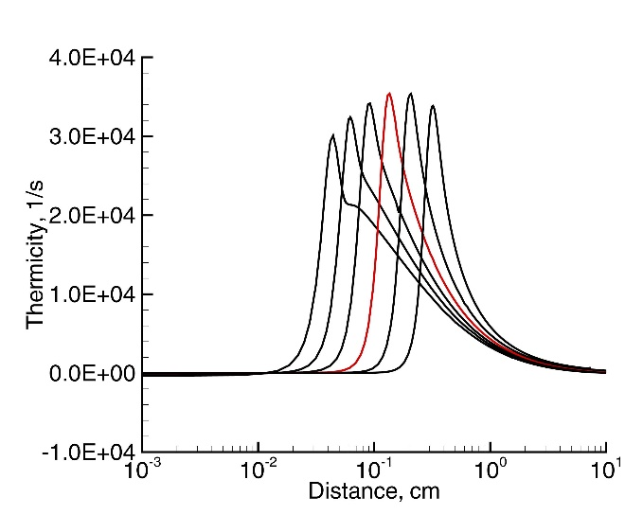
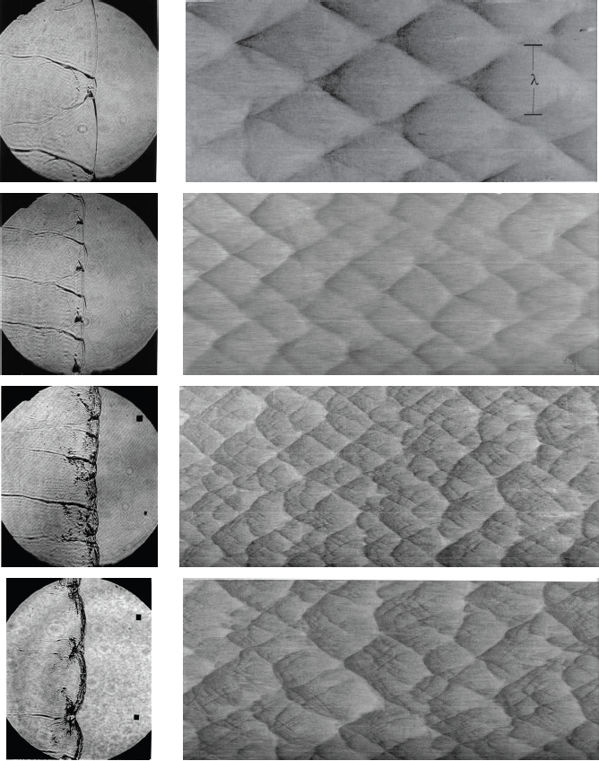
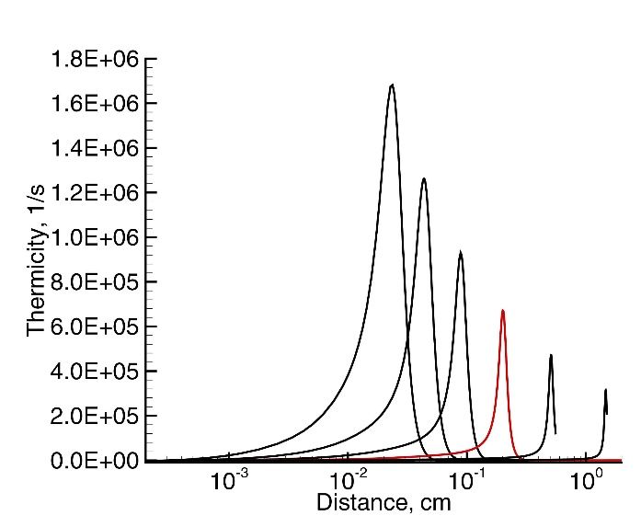
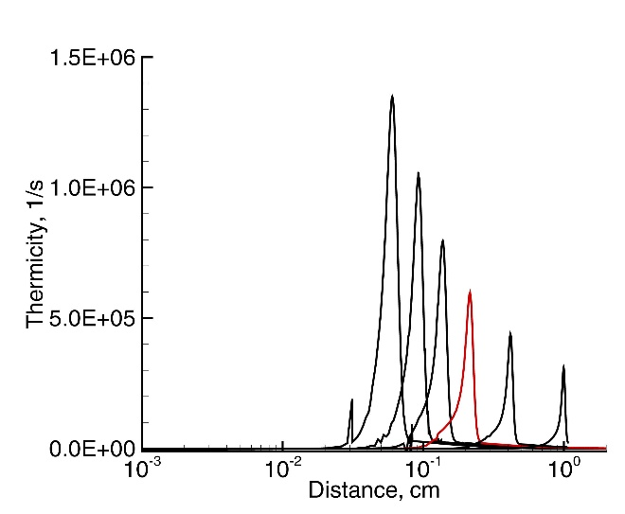
Austin 2003
2H₂+O₂+17Ar
2H₂+O₂+12Ar
H₂+N₂O+1.33N₂
C₃H₈+5O₂+9N₂

Slide 24
Initiation
Indirect: Sparks, heat → flames → turbulence → acceleration → localized explosions → transition from deflagration to detonation.
Direct: laser or electrical breakdown, high explosives or sensitive mixture detonation, high speed projectiles: Strong shock waves→ rapid initiation of combustion coupling directly to shock wave.

Slide 25
Early Studies with Projectiles
H₂-Air, 0.34 atm 2029 m/s 15 mm sphere-cylinder
H₂-Air, 0.34 atm 2605 m/s 15 mm sphere-cylinder
Lehr, 1972, Acta Astronautica 17, 589-597.
Notes:
From Akiko Matsuo thesis

Slide 26
Detonations?
We expected this:
But Lehr found this:
Oblique detonation
Decaying shock wave
Why? Where are the detonations?
Shepherd 1994

Slide 27
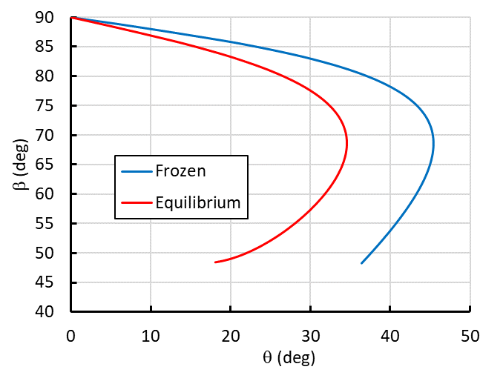
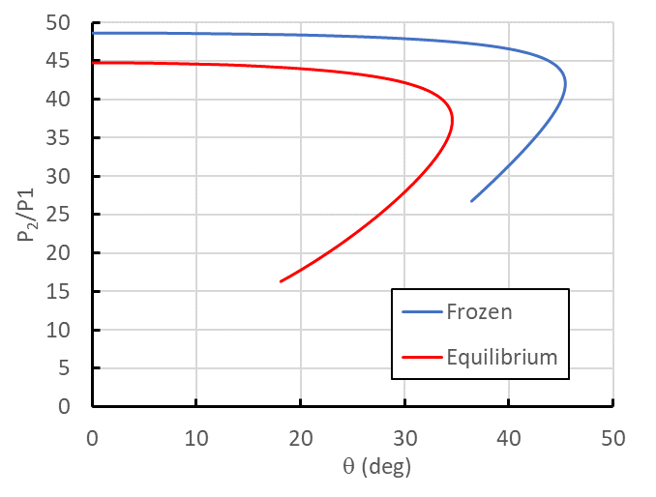
Quest for explanation
Projectile too slow?
  No, U > U_{CJ} (1944 m/s)
  Solutions for wave angle β possible for wide range of flow deflection θ angles
vN
CJ
CJ
vN

Slide 28
Questing further
Projectile too small?
  Nominal reaction time is 1.6 ms compared to flow time (d/V) of 10 to 20 μs.
Ideas:
  Hypersonics: Influence of shock and associated streamline curvature on reaction rate (Hornung, JFM, 1976) causes “freezing”
  Detonation: Relative size of reaction zone thickness (or cell size) compared to projectile dimensions

Slide 29
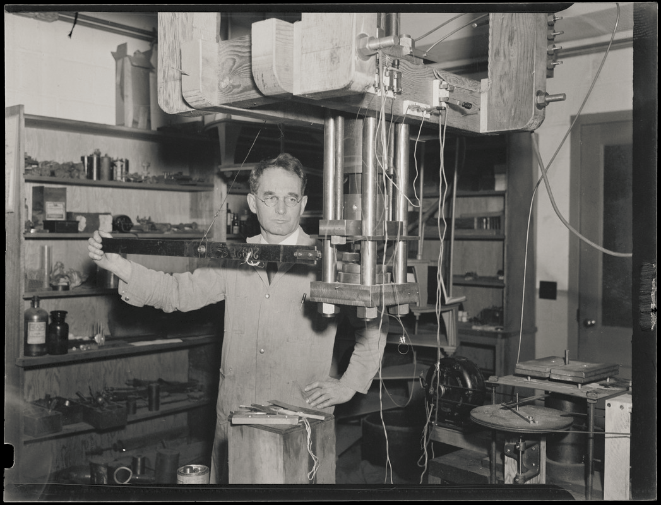
How to sort this out?
"The problem cannot be solved by the philosopher in his armchair, but the knowledge involved was gathered only by someone at some time soiling his hands with direct contact." Percy W. Bridgman

Slide 30
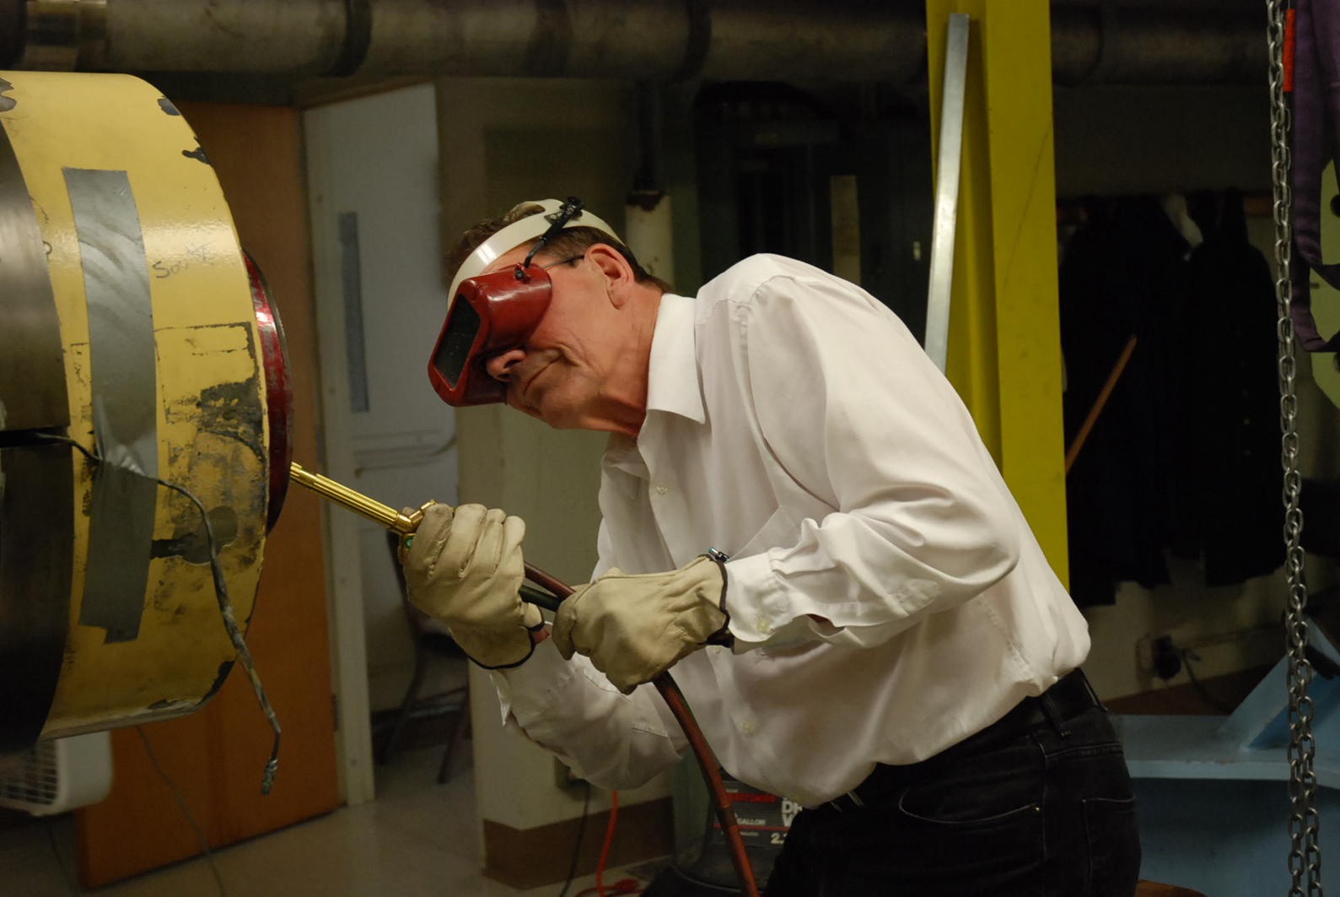
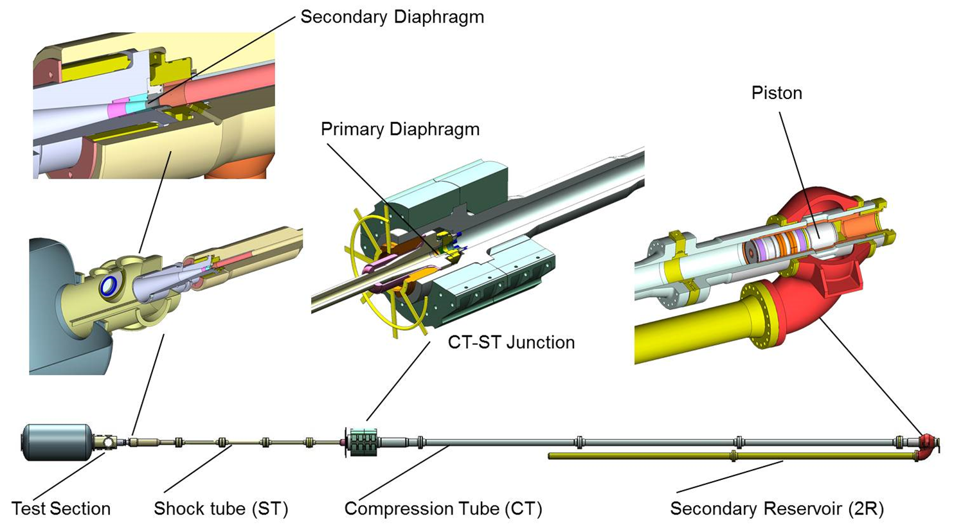
T5 Shock Tunnel

Slide 31
25 mm diameter nylon projectile
V_{p} = 2200 to 2600 m/s
2H₂ + O₂ + nN₂, 1 < n < 3.76
C₂H₄ + 3O₂ + mN₂, m = 5
C₂H₂ + 2.5O₂ + mN₂, m = 9.4
J. Bélanger, M. Kaneshige, and J.E. Shepherd. 1995, Kaneshige 1999.

Slide 32
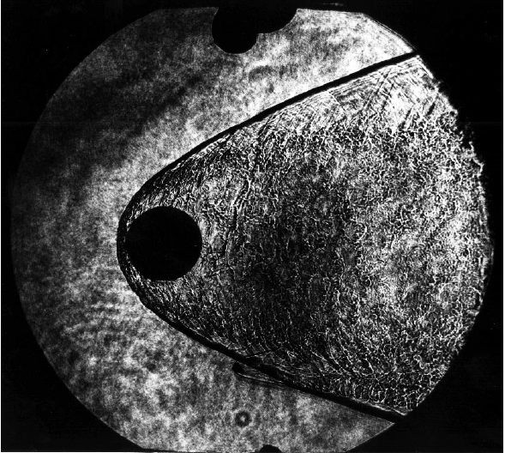
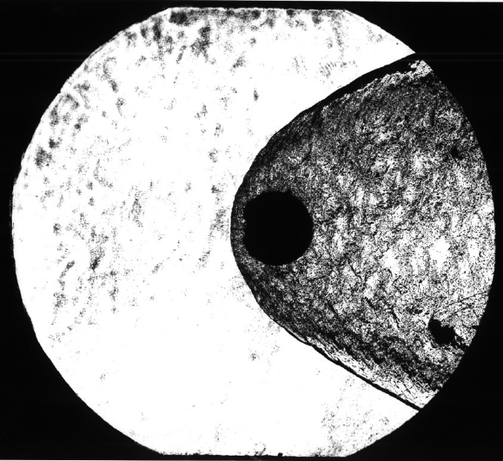
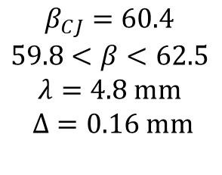
2H₂ + O₂ + 3.76N₂
0.1 bar, 2300 m/s
0.42 bar, 2430 m/s
$$β_{CJ}=60.4$$
$$59.8<β<62.5$$
$$λ=4.8 mm$$
$$Δ=0.16 mm$$
1.0 bar, 2230 m/s
1.70 bar, 22680 m/s

Slide 33
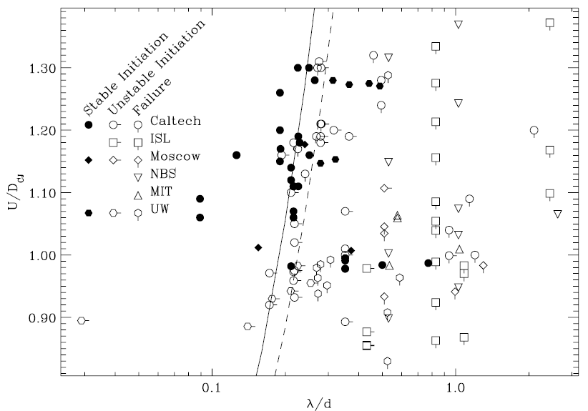
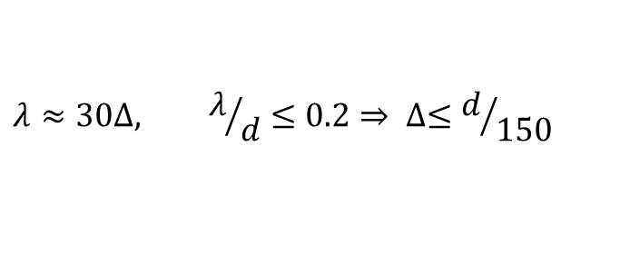
Reaction zone must be very thin!
$$λ≈30∆, λ/d≤0.2⇒ ∆≤d/{150}$$
Why must Δ⁄𝑑 be so small?
Kaneshige 1999

Slide 34
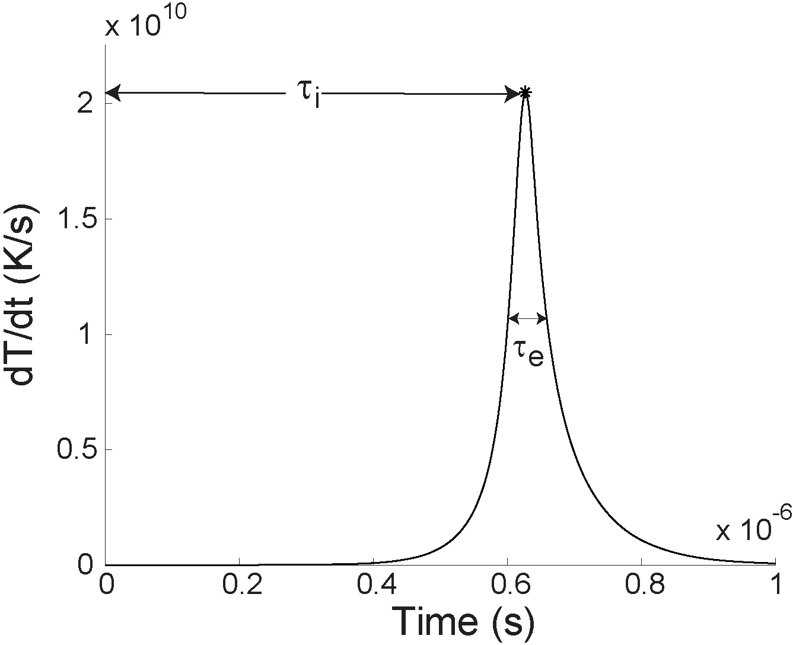
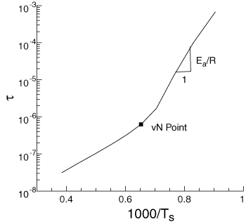

Reaction Rate Sensitivity to Temperature Changes
Temperature sensitivity measured by activation energy
$$θ=\frac{E_{a}}{RT}≈−\frac{T}{τ}\frac{dτ}{dT}$$
Induction Time
Energy Pulse Time
Stoichiometric H₂-Air, Browne et al 2005

Slide 35
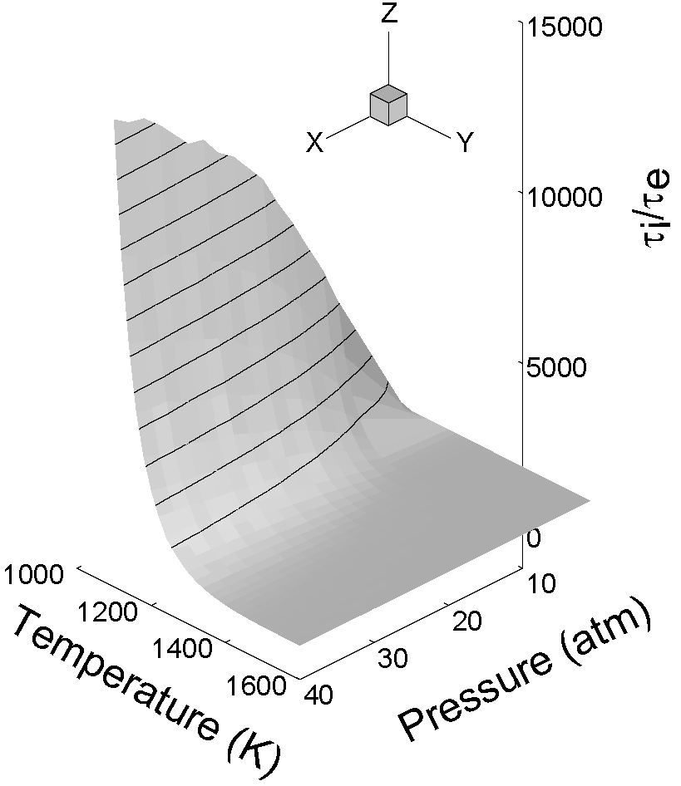
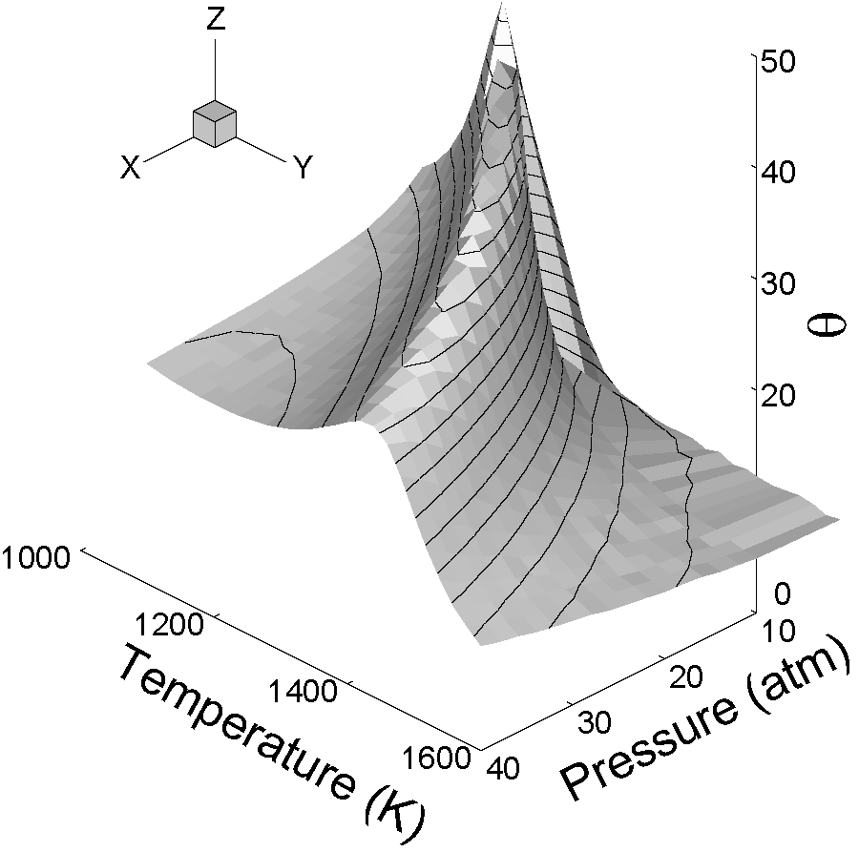
Nondimensional Figures of Merit
Extended second limit
0.8U_{CJ}
U_{CJ}
Browne et. al,, 2005, Liang et. al, 2006

Slide 36
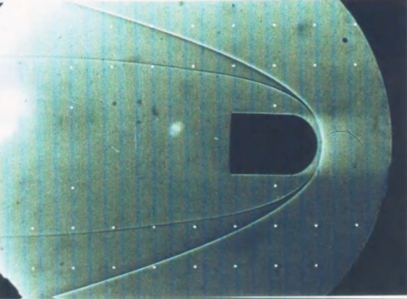








Effect of shock curvature
1, Decrease in $β$ results in decreasing $T$, increasing reaction zone thickness $∆$
Shock wave
Contact surface
$$n$$
$$u$$
Separation of reaction zone from shock
$$s$$
$$θ$$
2. Curved shock wave creates curved streamlines
bounding expanding stream tubes behind shock.
Consider 2-D steady flow in natural coordinates:
products
reactants
$$\frac{∂(ρu)}{∂s}=−ρu\frac{∂θ}{∂n}$$
$$\frac{∂}{∂s}(h+ \frac{u^{2}}{2})=0$$
Shocked but unreacted
$$ρu\frac{∂u}{∂s}=−\frac{∂P}{∂s}$$
$$u\frac{∂Y_{k}}{∂s}=Ω_{k}, k=1, 2,…,K$$
Along streamline, distance = function(time)
$$u\frac{∂}{∂s}=\frac{∂}{∂τ}$$
$$∇×u=u\frac{∂θ}{∂s}−\frac{∂u}{∂n}$$
$$ρu^{2}\frac{∂θ}{∂s}=−\frac{∂P}{∂n}$$
Kaneshige 1999, Hung 2003

Slide 37

Curved streamlines
Equivalent to stream tube expansion
Expansion competes with energy release
$$\frac{∂θ}{∂n}=\frac{1}{A}\frac{dA}{ds}$$

Slide 38
Consequence: critical curvature
Kaneshige 1999

Slide 39
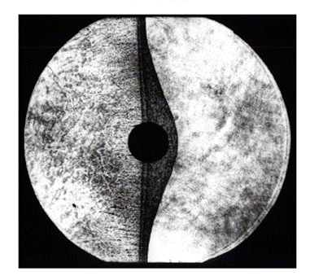
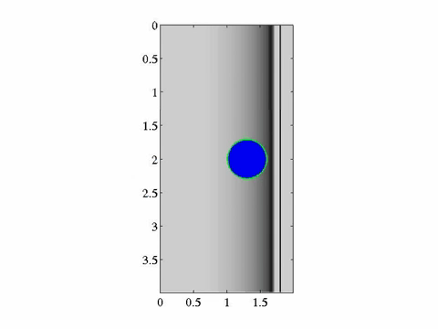
Initiation is a transient event
Kaneshige 1999
Hung 2003

Slide 40
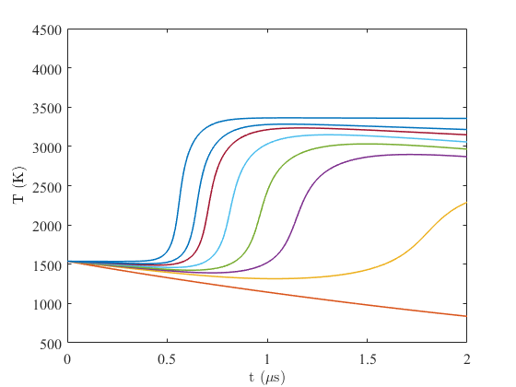
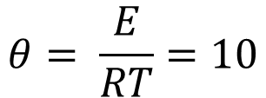


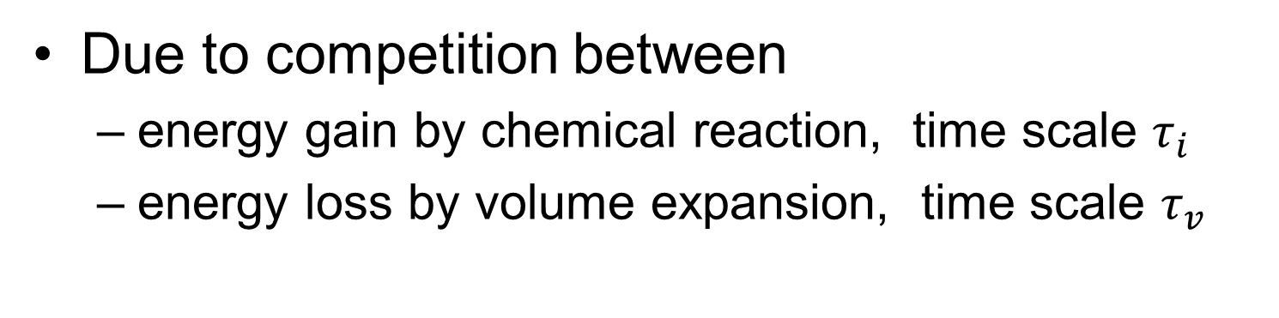


Critical Conditions
Due to competition between
  energy gain by chemical reaction, time scale $τ_{i}$
  energy loss by volume expansion, time scale $τ_{v}$
$$τ_{v}=V/{\frac{dV}{dt}}$$
$$∞$$
7
Nondimensional parameters
6
5
4
$$\frac{τ_{v}}{τ_{i}^{∗}}$$
3.5
$$τ_{i}^{∗}=0.55 μs$$
3
2
$$θ= \frac{E}{RT}=10$$
Stoichiometric H₂-Air, Us = 1975 m/s

Slide 41
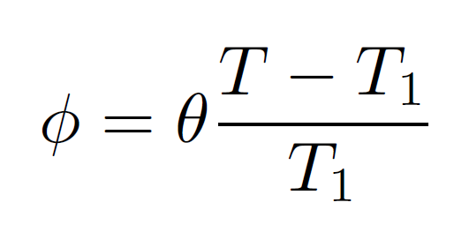
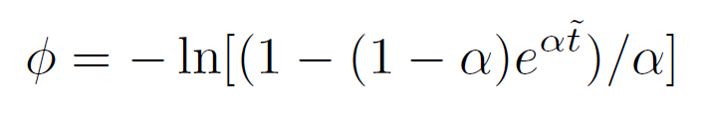
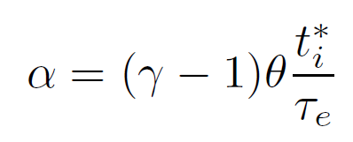


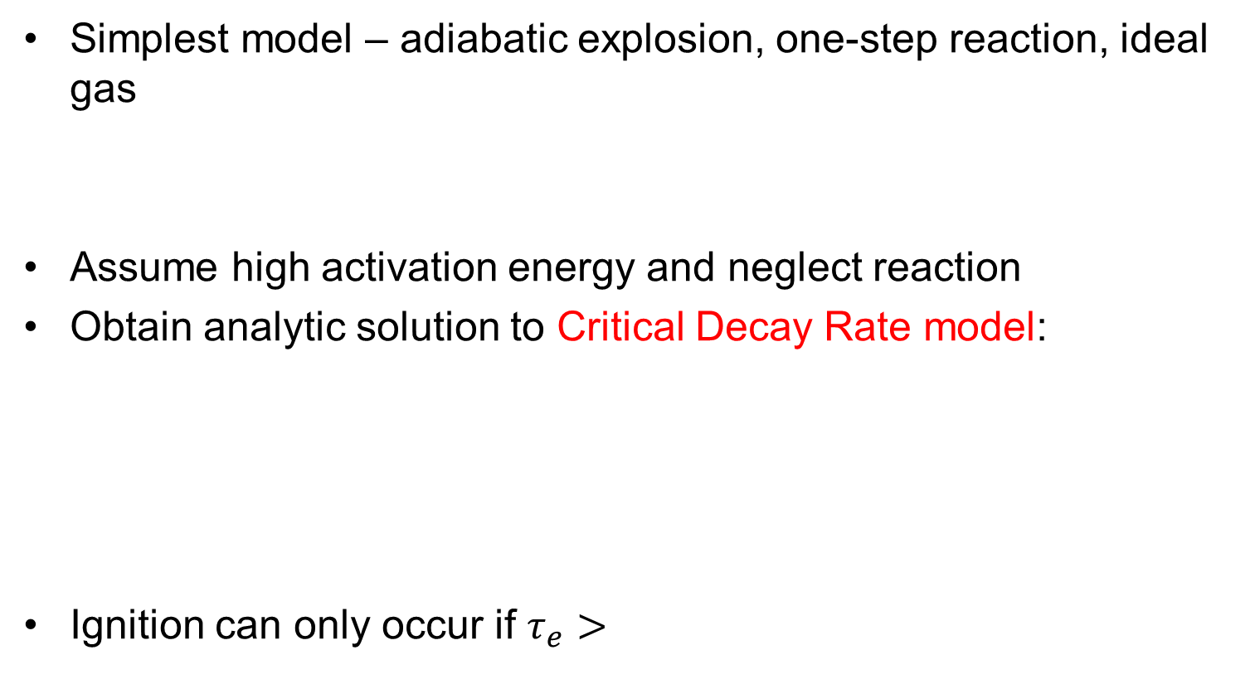



Analytical Model
Simplest model – adiabatic explosion, one-step reaction, ideal gas
Assume high activation energy and neglect reaction
Obtain analytic solution to Critical Decay Rate model:
Ignition can only occur if $τ_{e}>$
$$\frac{dU}{dt}=−P\frac{dV}{dt}$$
$$PV=MRT$$
$$\frac{dY}{dt}=A(1−Y)e^{−\frac{E_{a}}{RT}}$$
$$U=M\left(C_{v}T −qY\right)$$
$$C_{v}\frac{dT}{dt}=qA\left(1−Y\right)e^{−\frac{E_{a}}{RT}}−RT\frac{1}{V}\frac{dV}{dt}$$
Eckett et al 2000, Shepherd 2019

Slide 42
Initiation by Blast Waves
Eckett et al 2000

Slide 43
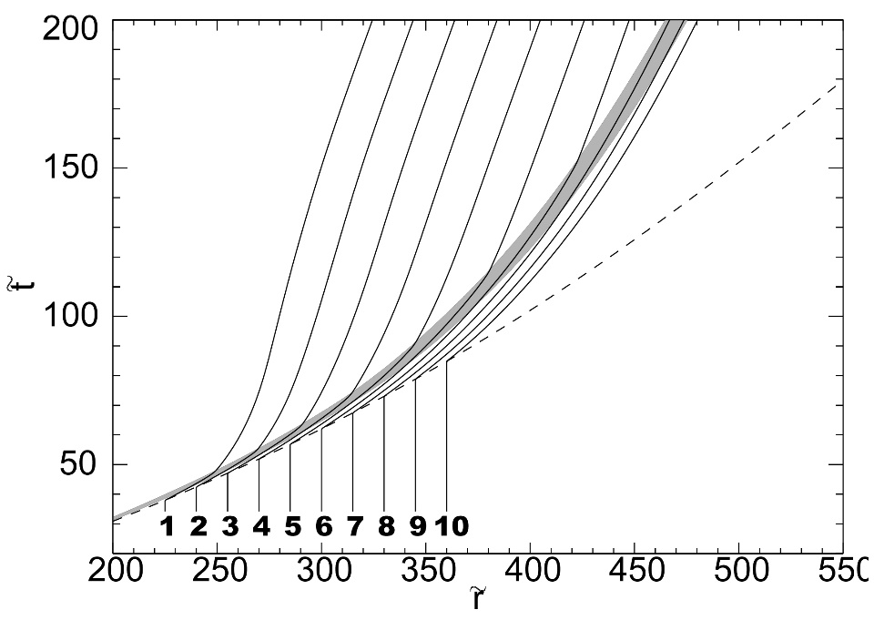
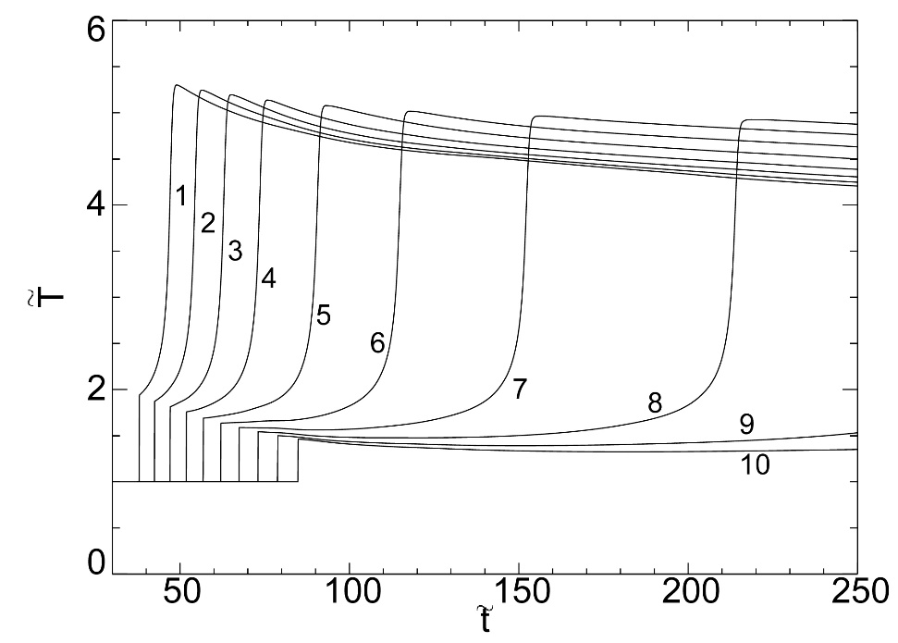
Key Role of Unsteadiness
Eckett et al 2000

Slide 44
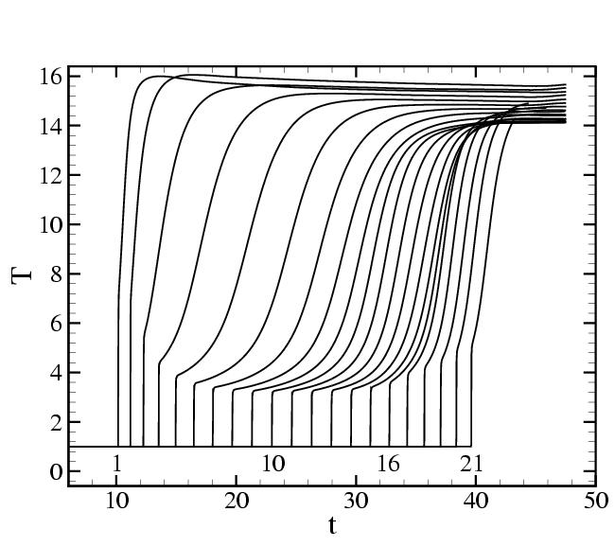
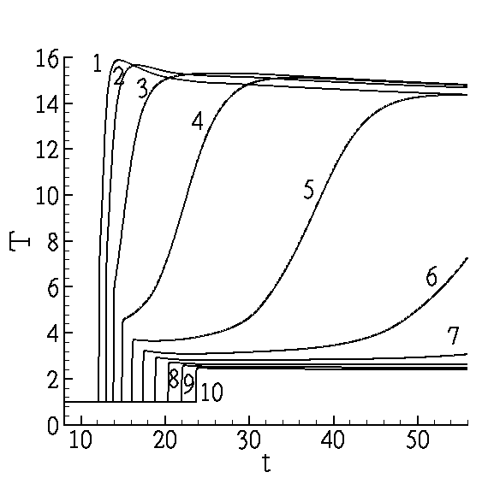
Critical Decay Rate Model
.
Quenching t_{d} < t_{d,c}.
Coupling, t_{d} > t_{d,c}.
Eckett et al 2000

Slide 45

Detonation Diffraction
P4
P5
P6
P1
P2
P3
accoustic corner
disturbance
signal
t₄
t₃
t₁
t₂
D
U_{CJ}
Schultz 2000, Pintgen 2004
diffracting
shock

Slide 46



Skews construction, Shock Waves
α
B. Skews, JFM 1967, Vol 29, 297-304 and 705-719.
Schultz 2000

Slide 47

Skew’s Construction, CJ Detonation
Schultz 2000

Slide 48



Skew’s Construction: ZND Detonation
Schultz 2000

Slide 49






Diffraction Types
Super-critical
C₂H₄+3O₂+4He 100 kPa
Near-critical
H₂+0.5 O₂ 100 kPa
Sub-critical
H₂+0.5 O₂70 kPa
Schultz 2000

Slide 50


Sub-critical
2H2 + O2 + 3Ar,
Po = 47.5kPa
shot 157
H2 + N2O,
Po = 42.5kPa
shot 152
schlieren
schlieren
PLIF
overlay
multiple exposure
chemiluminescence
image
type
150mm
80mm
70mm
80mm
109mm
image
height
Pintgen 2004

Slide 51


Critical
2H2 + O2 + 6.1Ar,
Po = 100kPa
shot 138
H2 + N2O,
Po = 42.5kPa
shot 145
schlieren
schlieren
PLIF
overlay
multiple exposure
chemiluminescence
image
type
150mm
80mm
70mm
80mm
109mm
image
height
Pintgen 2004

Slide 52


Super-critical
2H2 + O2 + 6.1Ar,
Po = 100kPa
shot 137
H2 + N2O,
Po = 45kPa
shot 143
schlieren
schlieren
PLIF
overlay
multiple exposure
chemiluminescence
image
type
150mm
80mm
70mm
80mm
109mm
image
height
Pintgen 2004

Slide 53

Critical Effects in Diffraction
Combination of wave curvature and unsteady effects.
Critical case dominant balance is between unsteadiness and energy release as in blast initiation
Arienti and Shepherd 2005, Arienti 2002

Slide 54
Critical Role of Activation Energy
Detonation locally decouples
and fails.
Shock-reaction coupling
is maintained.
θ_{CJ} = 4.15
θ_{CJ} = 3.5
Arienti and Shepherd 2005

Slide 55
Critical Conditions in Detonations
Observed in many situations:
  Projectile initiation, critical diameter or limiting wave curvature
  Blast wave initiation, critical initiation energy
  Detonation Diffraction, critical tube or channel width
Due to sensitivity of reaction rates to small changes in temperature – activation energy
Effect of thermodynamic state changes amplified by large activation energy
Competition between energy release by combustion and expansion of gases

Slide 56
Acknowledgements
Students, postdocs, researchers, and collaborators past and present on detonation projects:
  Hans Hornung, Ahmed Sabet, Mike Kaneshige, Jacques Belanger, Raza Akbar, Florian Pintgen, Joanna Austin, Eric Schultz, Marcia Cooper, Scott Jackson, Chris Eckett, Marco Arienti, Patrick Hung, Shannon Kao, Rita Liang, Jason Damazo, Donner Schoeffler, Branson Davis, Mark Frederick, Carson Slabaugh, and many others.
Financial support
  Caltech, Los Alamos, DOE, ONR.

Slide 57
References
Ahmed I. Sabet. Investigation of equilibrium and chemical kinetic behaviour of detonation waves in hydrogen-air mixtures and an evaluation of the oblique detonation wave as the combustor for a scramjet. Master's thesis, Rensselaer Polytechnic University, Troy, NY, May 1990.
J.E. Shepherd. Detonation waves and propulsion. in Combustion in High-Speed Flows, pages 373–420. Kluwer, 1994.
M.J. Kaneshige and J.E. Shepherd. Oblique detonation stabilized on a hypervelocity projectile.
In 26th Symposium (International) on Combustion, pages 3015–3022, Naples, 1996.
Hornung, H.G. “Gradients at a Curved Shock in Reacting Flow.” Shock Waves 8, no. 1 (February 1, 1998): 11–21.
Michael J. Kaneshige. Gaseous Detonation Initiation and Stabilization by Hypervelocity Projectiles.
PhD thesis, California Institute of Technology, Pasadena, California, January 1999.
C.A. Eckett, J.J. Quirk, and J.E. Shepherd. The role of unsteadiness in direct initiation of gaseous detonation. Journal of Fluid Mechanics, 421:147–183, 2000.
Eric Schultz. Detonation Diffraction Through an Abrupt Area Expansion. PhD thesis, California Institute of Technology, Pasadena, California, April 2000.

Slide 58
References
Joanna Austin.The Role of Instability in Gaseous Detonation..PhD thesis, California Institute of Technology, Pasadena, California, June 2003.
F Pintgen, CA Eckett, JM Austin, and JE Shepherd. Direct observations of reaction zone structure in propagating detonations. Combustion and Flame, 133(3):211–229, 2003.
Patrick Hung. Algorithms for Reaction Mechanism Reduction and Numerical Simulation of Detonations Initiated by Projectiles. PhD thesis, California Institute of Technology, Pasadena, California, June 2003.
Florian Pintgen Detonation diffraction in mixtures with various degrees of instability. PhD thesis, California Institute of Technology, Pasadena, California, December 2004.
M. Arienti and J.E. Shepherd. A numerical study of detonation diffraction. J. Fluid Mech., 529:117 – 146, 2005.
F. Pintgen and J. E. Shepherd. Stereoscopic imaging of transverse detonations in diffraction.
Journal of Flow Visualization and Imaging Processing, 14(1):121–142, 2007.
F Pintgen and J E Shepherd. Detonation diffraction in gases. Combustion and Flame, 156(3):665–677, 2009.
J.E. Shepherd. Ignition modeling and the critical decay rate concept. Technical Report EDL2019.002, Graduate Aeronautical Laboratories, California Institute of Technology, December 2019.

Slide 59
Resources
Explosion Dynamics Laboratory. SDToolbox: Numerical tools for shock and detonation wave modeling. GALCIT Report FM2018.001, California Institute of Technology, Pasadena, CA, January 2020. https://shepherd.caltech.edu/EDL/PublicResources/sdt/
Caltech Explosion Dynamics Website: https://shepherd.caltech.edu/EDL/
Most of our publications available for public download from EDL website or from: https://library.caltech.edu/caltechauthors

Slide 60
Background on Detonations
The classic reference on detonation is: Ya. B. Zel’dovich and A. S. Kompaneets. Theory of Detonation. Academic Press, NY, 1960. This is an English translation of original Russian. Out of print and in many ways out of date.
A more recent theoretical treatment is given by: W. Fickett and W. C. Davis. Detonation. University of California Press, Berkeley, CA, 1979 Now available as a Dover paperback.
The best reference on gaseous detonations is: JHS Lee, The Detonation Phenomenon, Cambridge 2008.
Zhang, F. 2012. Detonation Dynamics. Vol. 6. Shock Wave Science and Technology Reference Library.Springer Verlag. Some overlap with Lee and F&D but discusses a number of specialized topics that they do not cover.
J. E. Shepherd. Detonation in gases. In Proceedings of the Combustion Institute, volume 32, pages 83–98, 2009. My survey paper. Companion presentation is on the EDL website.
M. D. Frederick, R. M. Gejji, J. E. Shepherd, and C. D. Slabaugh. Statistical analysis of detonation wave structure. Proceedings of the Combustion Institute, 2022. The most recent work on propagating detonation wave properties.

