Slide 1
Detonation in Gases
Joseph E Shepherd
Aeronautics and Mechanical Engineering
California Institute of Technology
Pasadena, CA 91125 USA
Combustion Symposium
McGill University August 2008

Slide 2
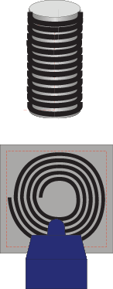
Marcelin Berthelot
Paul Vielle
1881
Ernest Mallard
Henry Le Chatelier
2006

Slide 3

Marcelin Berthelot
Paul Vielle
Ernest Mallard
Henry Le Chatelier
C₃H₈+5O₂ 20 kPa
Jackson, Lee, and Shepherd 2016

Slide 4
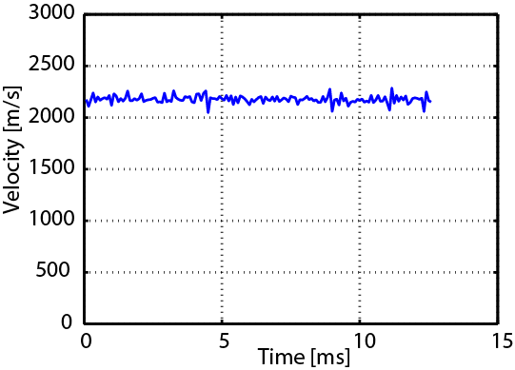
Marcelin Berthelot
Paul Vielle
Ernest Mallard
Henry Le Chatelier

Slide 5

Donald Chapman
Ehrile Jouguet
1889-1905

Slide 6
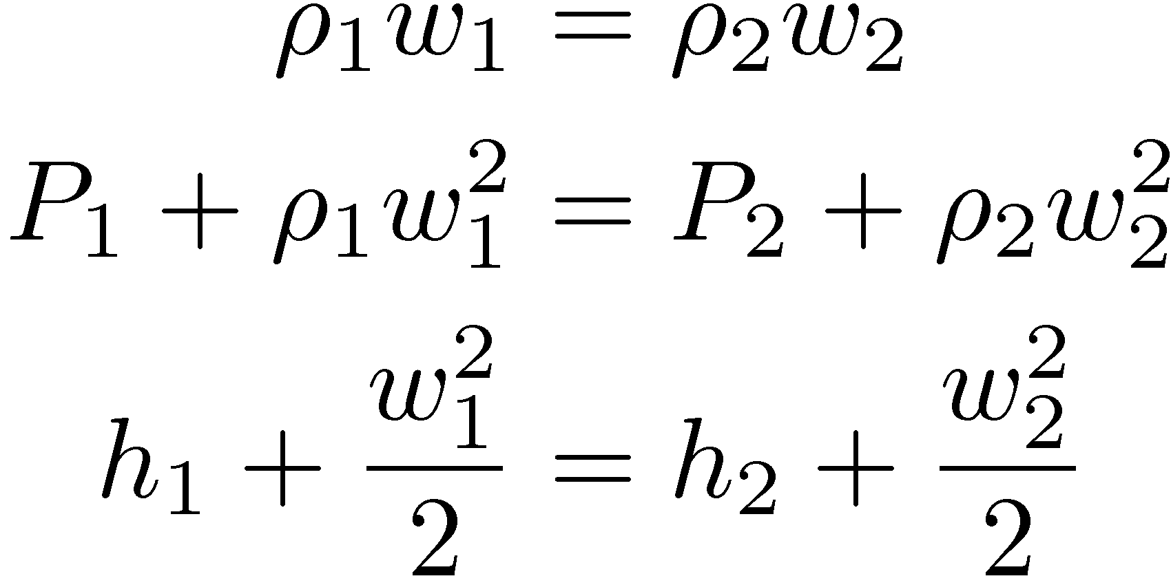
Donald Chapman
Ehrile Jouguet

Slide 7
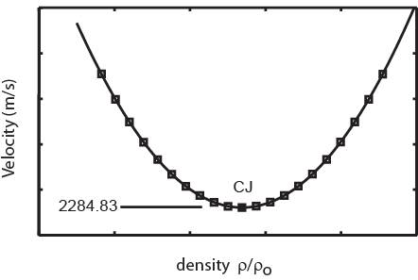
Donald Chapman
Ehrile Jouguet
or
Sonic flow relative to wave

Slide 8
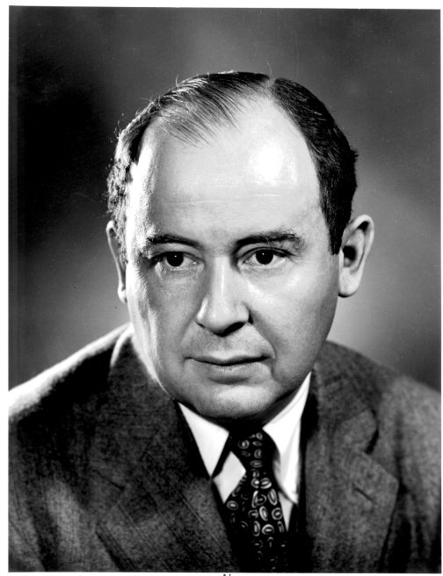
”ZND’’ 1940-43
Yakov Zel’dovich
John von Neumann
Werner Döring
shock
products
reactants
Temperature
products
Cold fuel/oxidizer mixture
radicals
Sonic
plane
induction zone
Energy release

Slide 9
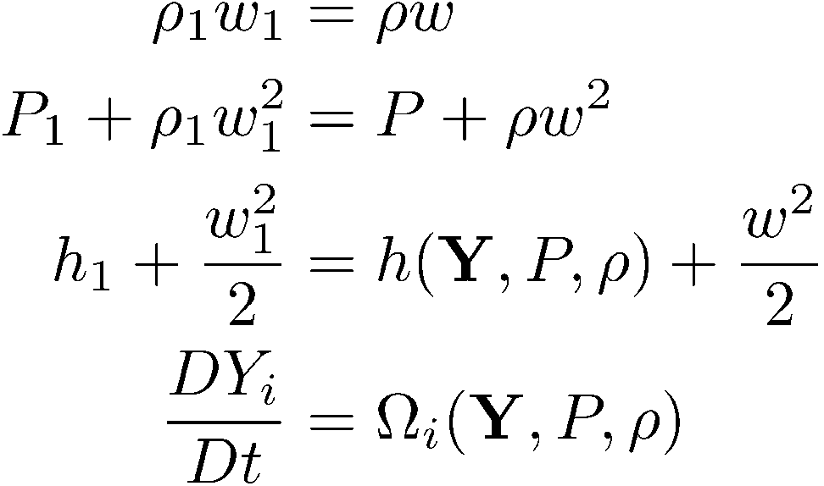
”ZND’’ 1940-43
P
vN
CJ
1
v

Slide 10
”ZND’’ 1940-43
thermicity

Slide 11
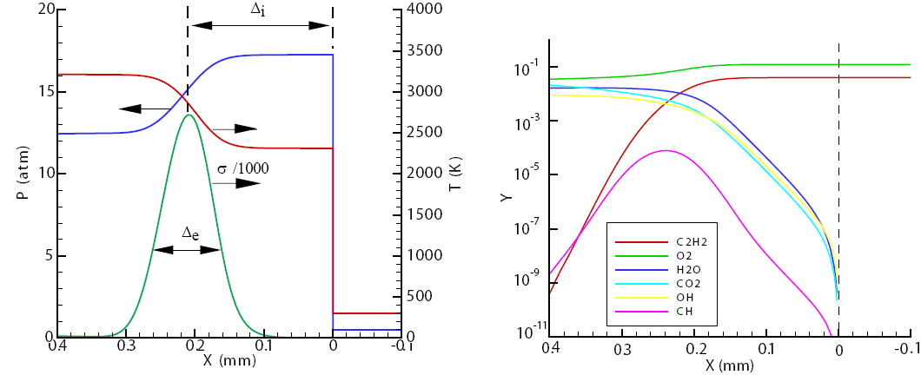
”ZND’’ 1940-43

Slide 12
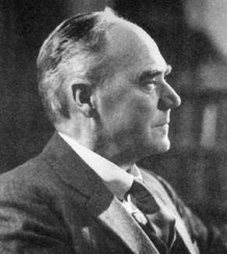
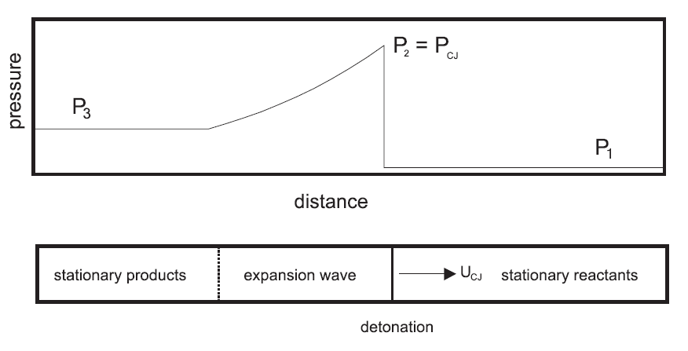
G. I. Taylor
particle path
t
3
Stationary region
2
1
0
X

Slide 13
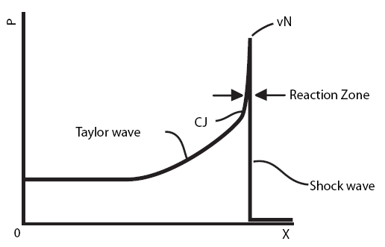
Bach et al 1969

Slide 14
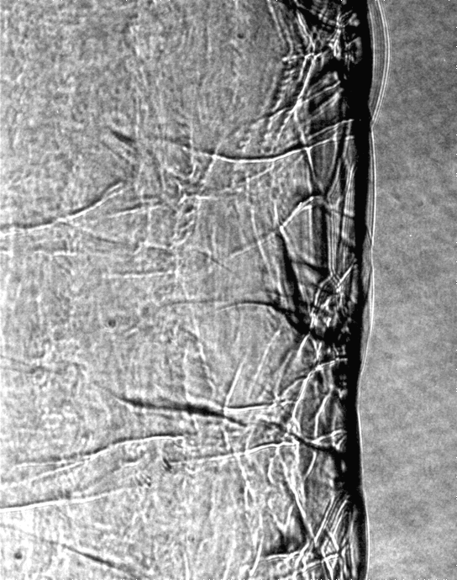

Slide 15
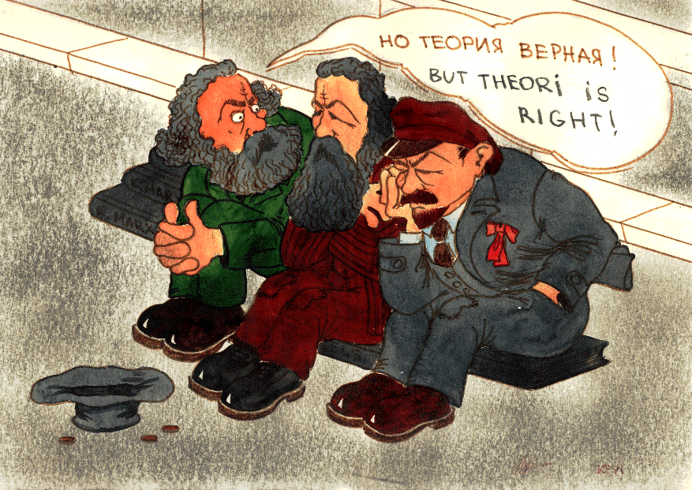

Slide 16
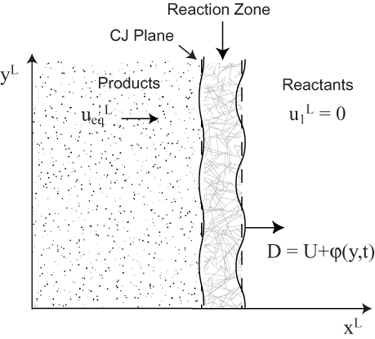
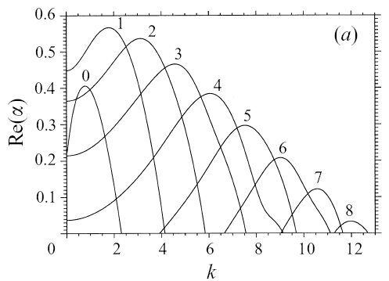
Erpenbeck 1964, Lee and Stewart 1990, Short, Sharpe, Kasimov, Tumin, …

Slide 17
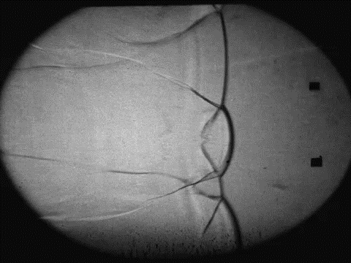
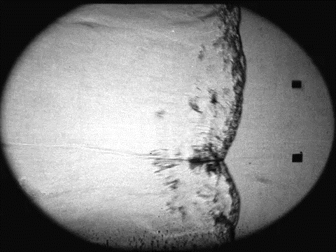
2H2-O2-85%Ar
P_{o}=20kPa
C3H8-5O2-60%N2
P_{o}=20kPa
scale:4mm
Austin 2003
Notes:
Movies obtained by Joanna Austin in Explosion Dynamics Laboratory, Caltech PASADENA, CA.
Joanna Austin. The Role of Instability in Gaseous Detonation.
PhD thesis, California Institute of Technology, Pasadena, California, June 2003.

Slide 18
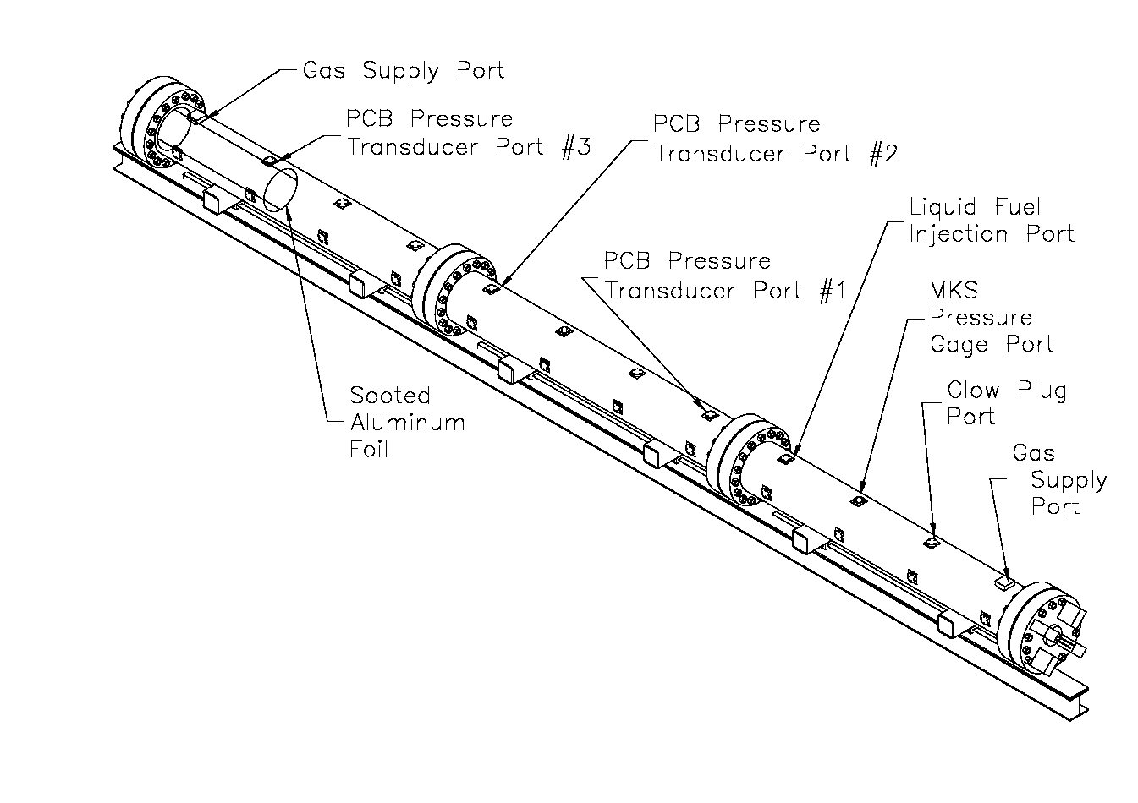
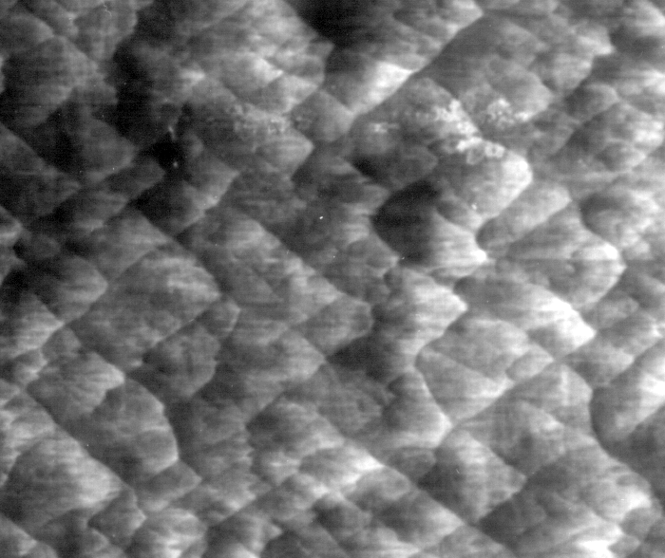
Soot foil:
Cell width measurements
λ
M. Kaneshige and J.E. Shepherd. Detonation database. Technical Report FM97-8,
Graduate Aeronautical Laboratories, California Institute of Technology, July 199
Notes:
See R. Akbar, M. Kaneshige, E. Schultz, and J.E. Shepherd.
Detonations in H -N O-CH -NH -O -N mixtures.
Technical Report FM97-3, GALCIT, July 1997.
And
JM Austin and JE Shepherd.
Detonation in hydrocarbon fuel blends.
Combustion and Flame, 132(1-2):73-90, 2003.
And
J.-P. Hébral and J. E. Shepherd.
User guide for detonation cell size measurement using photoshop and matlab.
Technical Report FM00-6, California Institute of Technology, December 2000.
Explosion Dynamics Laboratory Report.

Slide 19
Strehlow 1967 2H2+O2+7Ar
Gamezo et al 1999 E/RT = 7.4 DY/Dt = -A(1-y) exp(-E/RT)

Slide 20
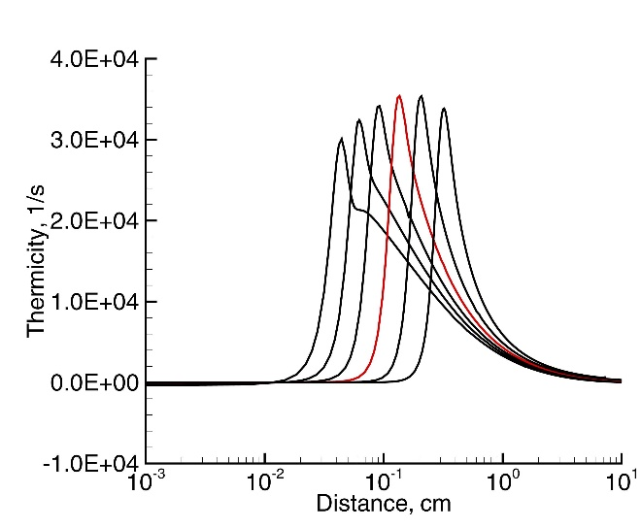
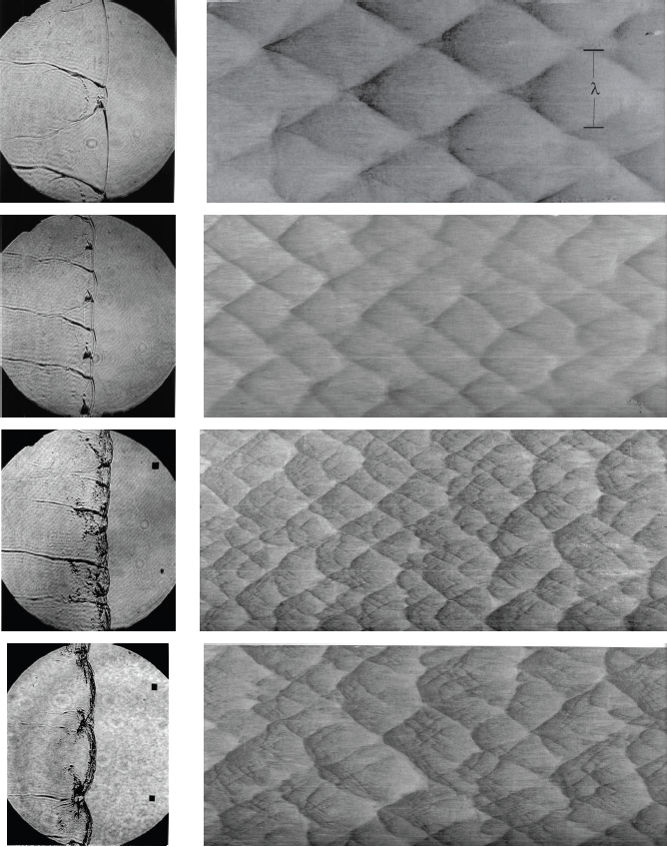
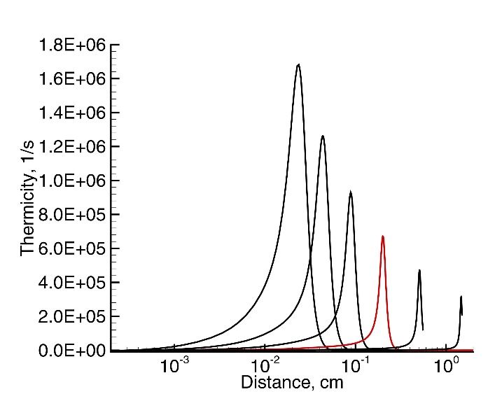
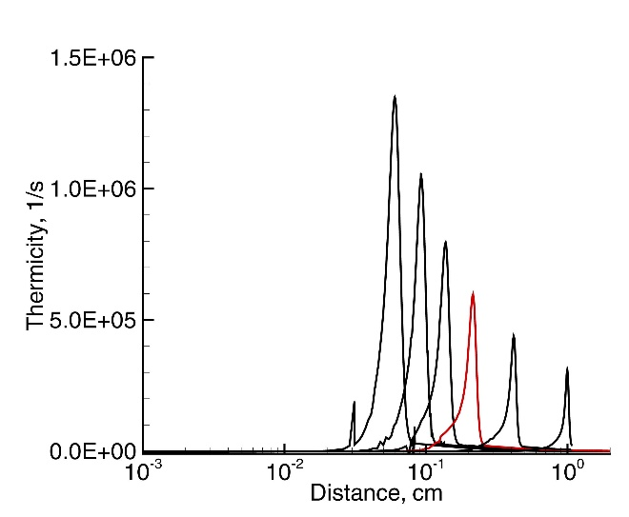
2H2+O2+17Ar
2H2+O2+12Ar
H2+N2O+1.33N2
C3H8+5O2+9N2
Austin 2003

Slide 21
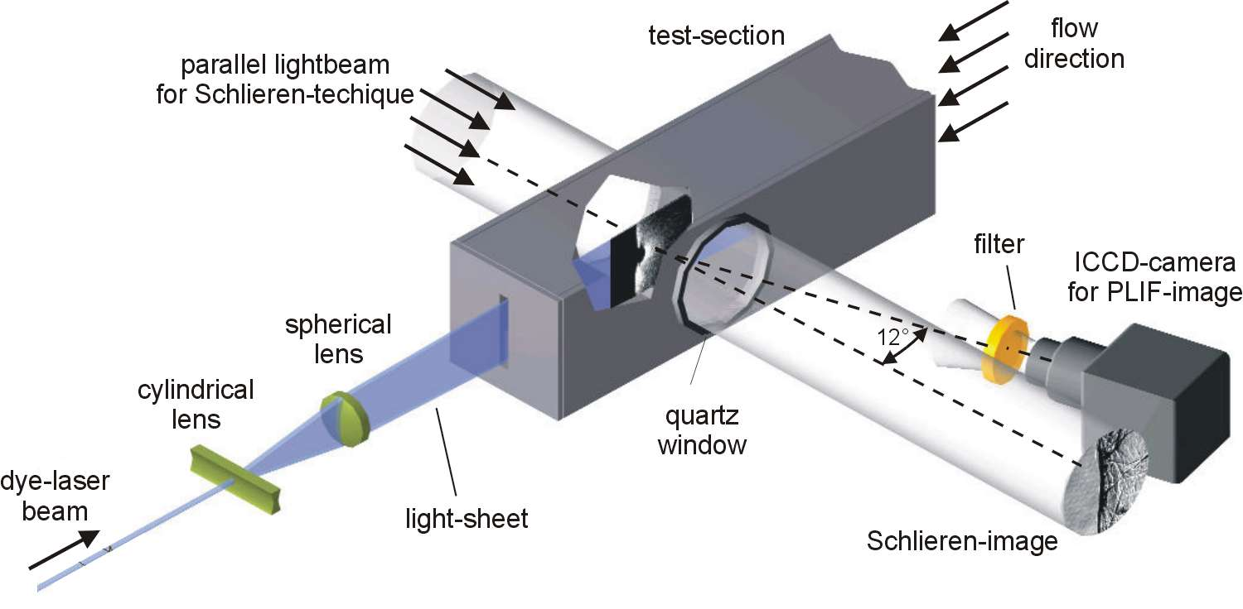
Pintgen 2000
Notes:
Discuss this – plane image.

Slide 22
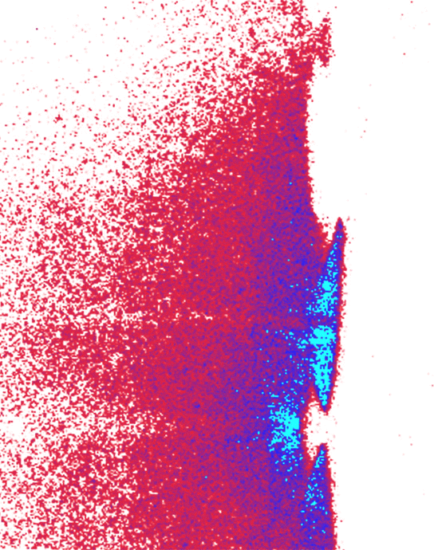
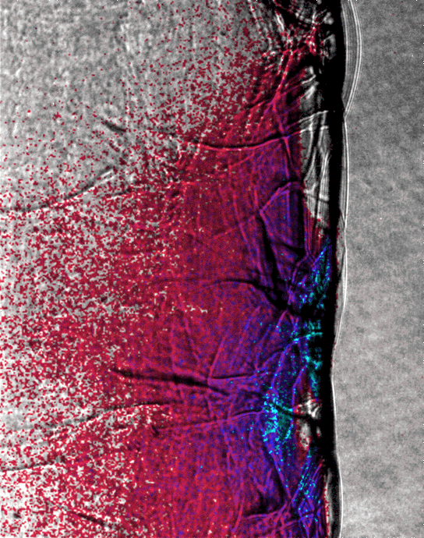
2H2+O2+17Ar, 20kPa cellsize: 48 mm
ZND-calculated Induction-zone-length at CJ-state: 1.6 mm
∇ρ
[OH]
Pintgen 2000

Slide 23
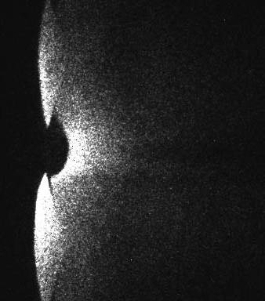
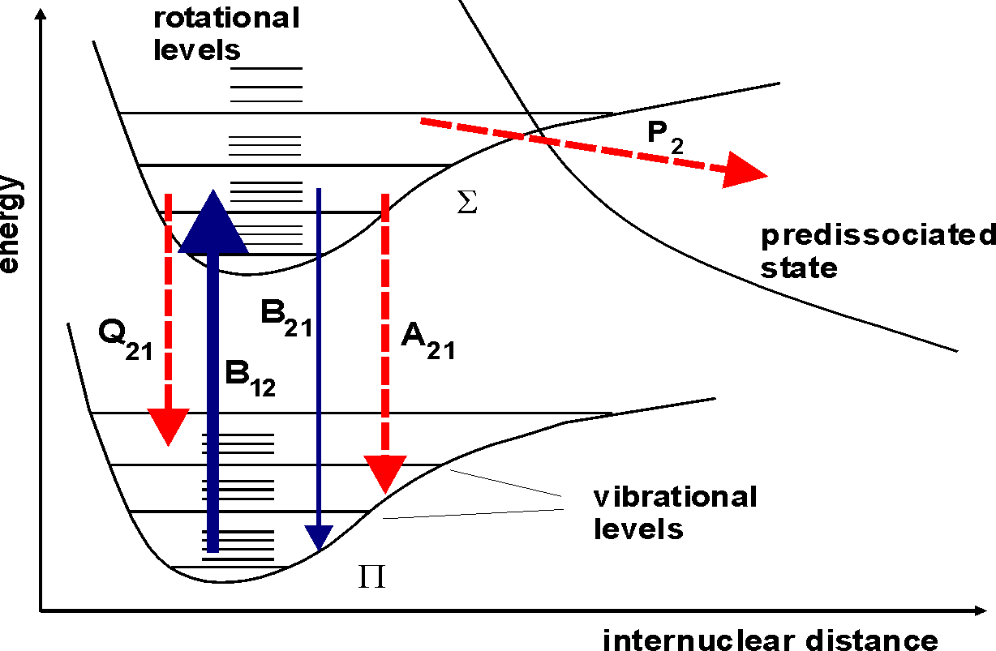
2H2+O2+85%Ar, 20kPa
.
A₂₁
S_{F} = C B₁₂ N₀ I_{ν} Γ
.
A₂₁+ Q₂₁ +P₂
Pintgen 2004

Slide 24
Austin 2003

Slide 27
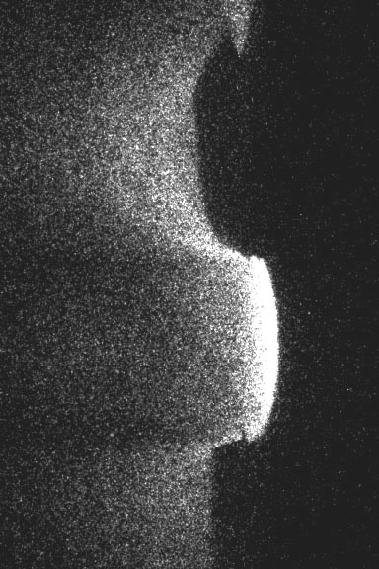
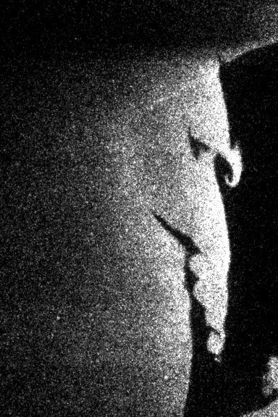
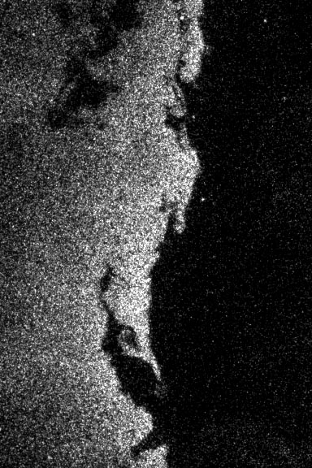
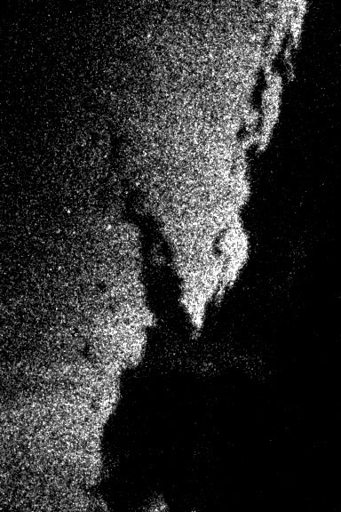
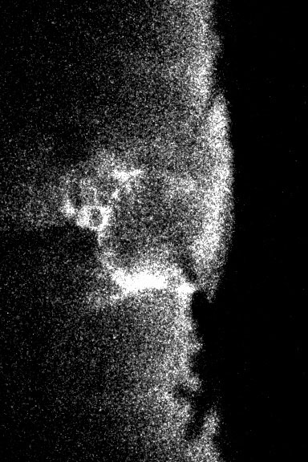
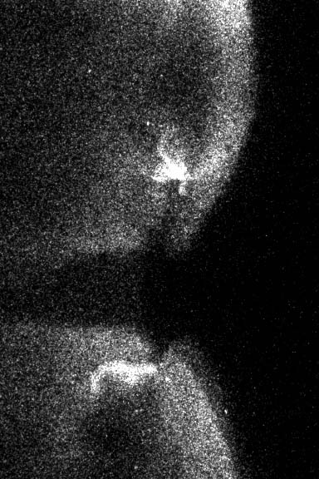
2H2+O2+17Ar
2H₂+O₂+ 8 N₂
H2+ N2O +3 N2
C2H4-3O2-10.5N2
C3H8-5O2-9N2
C3H8-5O2-9N2
Notes:
It is not possible to construct a coherent series, since there are random shot to shot variations in the number
of modes and in the phasing of the transverse waves.
Despite this, one can assume that the right image was taken at a later stage in the cellular cycle

Slide 28
Eckett 2000
Ng et al 2005

Slide 29

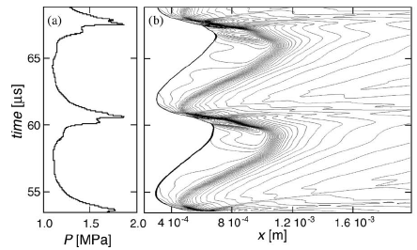
P
f > 1
CJ
f = 1
1
V
Daimon & Matsuo 2008

Slide 30
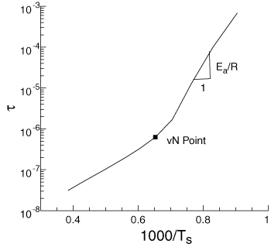
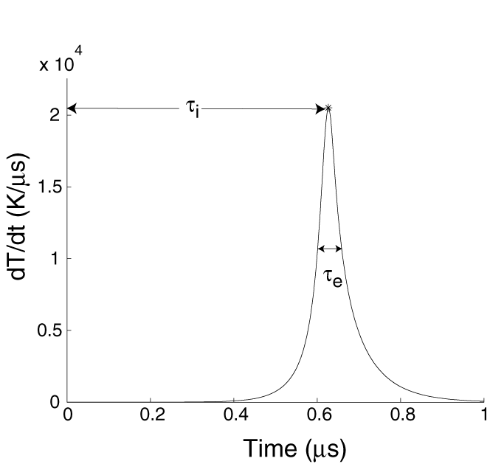
τ_{i} – Induction Time
τ_{e} – Energy Release Pulse Width
θ – Reduced Effective Activation Energy
θ = E_{a}/RT
τ_{i}/τ_{e}
Stoichiometric H₂-Air post-shock state for CJ detonation, pre-shock conditions: 1 atm, 300 K Mechanism: GRI 3.0

Slide 31
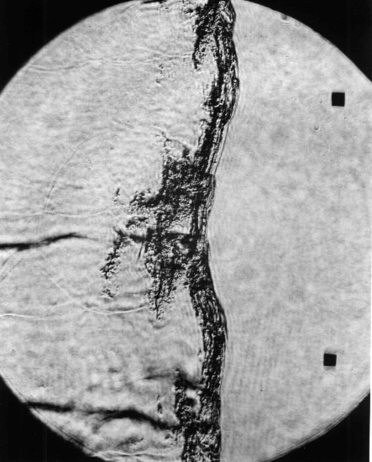
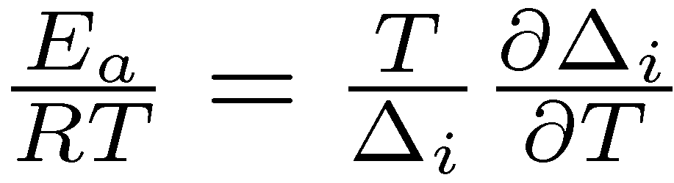
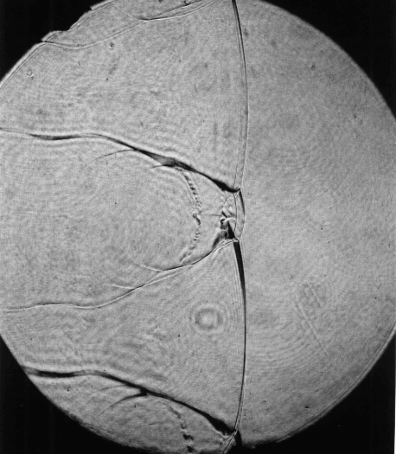
f=1
unstable
highly unstable
(high E_{a}/RT_{S})
stable
Austin, Pintgen and Shepherd 2005
weakly unstable
(low E_{a}/RT_{S})

Slide 32
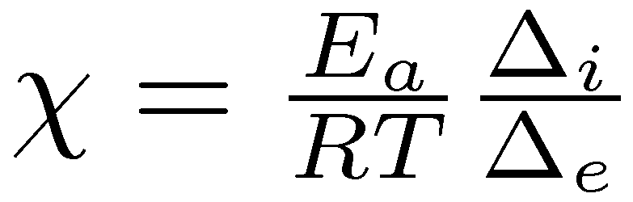
Ng et al 2005

Slide 33
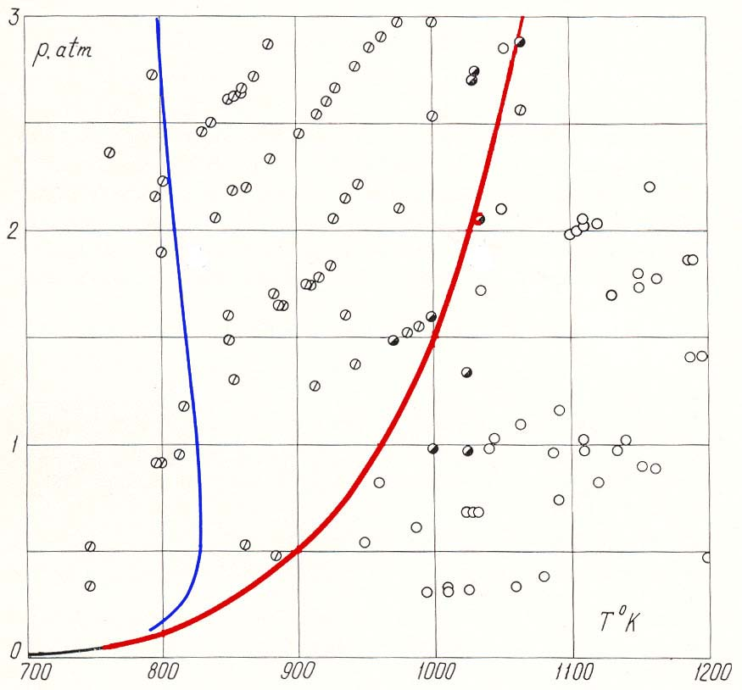
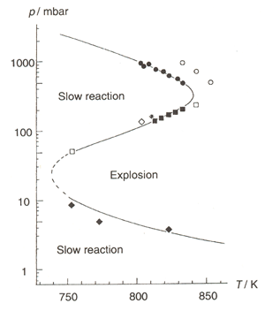
H₂-O₂ Chemistry: Explosion Limits
Classical Explosion Limits
HO₂ Diffuses to Walls
3
3
2’
2
Voevodesky & Soloukhin (1965)
2
1
Extended Second Limit
H₂O₂ Enables Explosion
Lewis & von Elbe (1961)

Slide 34
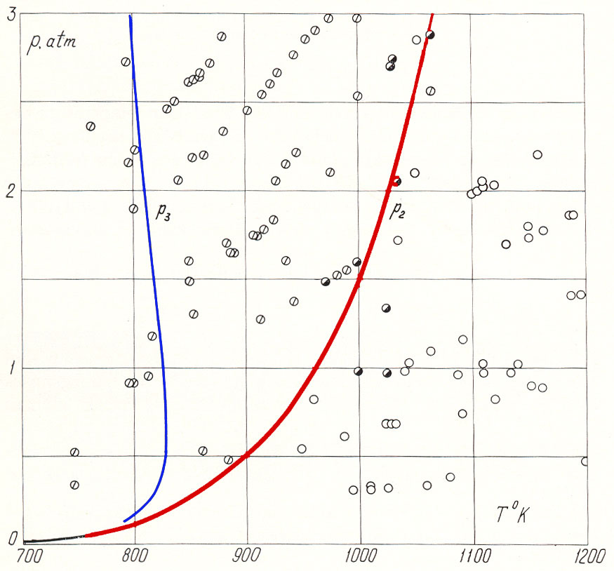
H₂-O₂ Chemistry: Two Pathways
Peroxide Straight-Chain Pathway
H + O₂ + M → HO₂ + M
HO₂ + HO₂ → H₂O₂ + O₂
H₂O₂ + M → 2 OH + M R1
(Rate Limiting Step)
Chain-Branching Pathway
H + O₂ → OH + O R2
(Rate Limiting Step)
O + H₂ → OH + H
OH + H₂ → H₂O + H

Slide 35
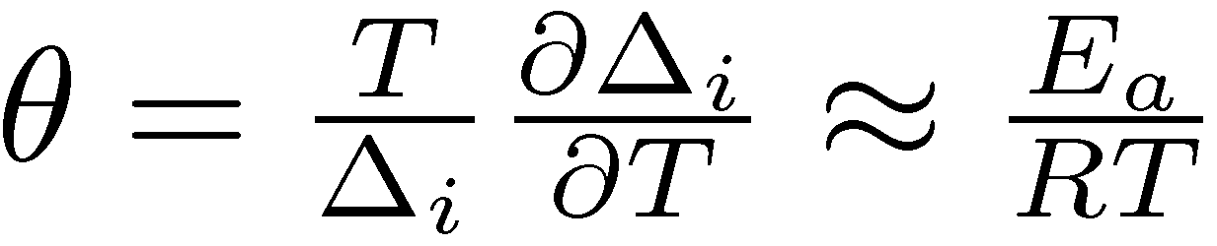
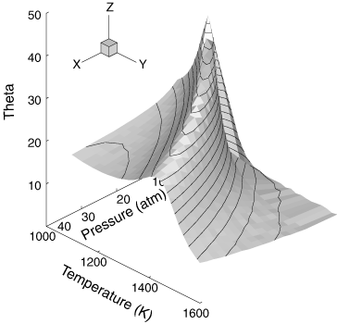
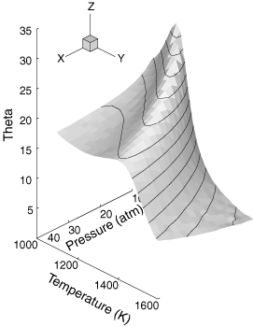
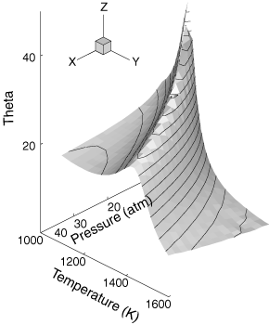
Stoichiometric H₂-Air
Lean H₂-Air φ = 0.8
Rich H₂-Air φ = 3.0
S. Browne, Z. Liang, and J. E. Shepherd. 2005,2006

Slide 36
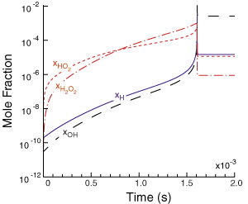
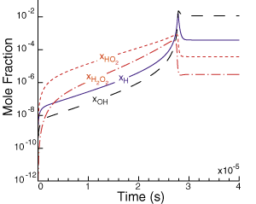
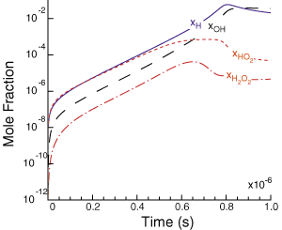
Lean H₂-Air φ = 0.35
Peroxide Pathway Dominant
Lean H₂-Air φ = 0.5
Competition
Stoichiometric H₂-Air
Branching Pathway Dominant
Initial Conditions
T = 300 K, P = 0.7 atm
Browne, Liang, Shepherd 2005

Slide 37


Detonation limits?
α=1
α=2
H + O₂ → OH + O R1
H + O₂ + M → HO₂ + M R2
r₂/r₁ = α
Cross-over Temperature Cannot Predict Limits
Shepherd 1986

Slide 38





Stoichiometric CH₄-Air
Stoichiometric C₂H₆-Air
S. Browne, Z. Liang, and J. E. Shepherd. 2005,2006
Stoichiometric C₂H₄-Air
Stoichiometric C₂H₂-Air
Stoichiometric C₃H₈-Air
Notes:
From 2006 ASCI presentation

Slide 39



Ratio of Time Scales (τ_{i}/τ_{e})
Stoichiometric CH₄-Air
Stoichiometric H₂-Air
Stoichiometric CH₄-Air
Stoichiometric C₂H₂-Air
S. Browne, Z. Liang, and J. E. Shepherd. 2005,2006

Slide 40

Hydrocarbon Oxidation
Many Pathways
CO Oxidation
CO + O₂ --> CO₂ + O
CO + OH --> CO₂ + H
CO + HO₂ --> CO₂ + OH
CH₄ Oxidation
CH₄ + X --> CH₃ + XH
CH₃O + M --> H₂CO + H + M
H₂CO + X --> HCO + XH
HCO + M --> H + CO + M
Additional Pathways Can Bypass Competition Effect
NO CROSS-OVER TEMPERATURE

Slide 41
Modeling Competing Radicals
Model Chemistry
Hydrogen Chemistry
Shepherd PAA 86
Dold & Kapila CF 91, Short & Quirk 97 JFM
Initiation
K
1
(
1
)
R
→
B
Branching
pathway
K
2
(
2
)
R
+
B
→
2
B
+
+
K
3
Peroxide
pathway
(
3
)
R
B
M
→
C
+
M
K
4
(
4
)
C
→
2
B
Termination
+
+
K
5
(
5
)
B
B
M
→
Pr
+
2
M
Psuedo species: R (H₂, O₂), B (OH, H, O), C (HO₂, H₂O₂), Pr(H₂O)
Liang, Browne, Deiterding, and Shepherd 2007

Slide 42

Ucj=1785 m/s θ=4.3
U=0.85Ucj θ=7.2
Effective Activation Energy θ
Case1
2H₂+O₂+17Ar
θ~5
Ucj=1390 m/s θ=10
U=0.85Ucj θ=29
Case2
r₃ =1.5r₂
Extended second limit
Liang, Browne, Deiterding, and Shepherd 2006, 2007

Slide 43


ZND Structures
Case 1
Case 2
Case 2
Ucj Δ=0.029 mm Δ_{i}/Δ_{e}=0.9 85%Ucj Δ=0.16 mm Δ_{i}/Δ_{e} =1.5
Ucj Δ=0.64 mm Δ_{i}/Δ_{e}=1.3 85%Ucj Δ=275 mm Δ_{i}/Δ_{e} =33
Y_{B} is much larger than Y_{C}
Y_{B} is comparable with Y_{C}
Liang, Browne, Deiterding, and Shepherd 2007

Slide 44


Species “B” (OH, H, or O)
Unburned
Case 1
regular structure
Y_{B} (OH)
Liang, Browne, Deiterding, and Shepherd 2007
Unburned
Case 2
irregular structure
Y_{B} (OH)

Slide 45






Case 1 regular structure
Case 1
Inaba & Matsuo
2001
Case 2
reacting
transverse
detonation
Gamezo et.al 2000
Case 2 irregular structure
Notes:
11th International Conference on Numerical Combustion
Granada, Spain, April 23-26, 2006

Slide 46


Fluctuations in Shock Velocity
Case 1
Case 2
₁
₂
₃
₁
₁
₂
₂
₃
₃
Liang, Deiterding, Browne and Shepherd 2006
Notes:
11th International Conference on Numerical Combustion
Granada, Spain, April 23-26, 2006

Slide 47


PDF – Velocity, Acceleration
Case 1
Case 1
Case 2
Case 2
Mean velocity for both cases
Most likely velocity for both,
lower for irregular mixture
Regular mixture: 0.8 U_{CJ}~1.35 U_{CJ}
Irregular mixture: 0.7 U_{CJ}~1.5 U_{CJ}
`Regular mixture:
- most likely
Irregular mixture
- most likely
- faster decay rate!
Liang, Deiterding, Browne and Shepherd 2006

Slide 48


Fluctuations in Reaction Length
Case 1
Case 2
₁
₂
₃
Liang, Deiterding, Browne and Shepherd 2006

Slide 49


PDF – Reaction thickness
Case 1
Case 2
Regular mixture
Most likely
Irregular mixture
Regular mixture slower acceleration
Irregular mixture faster acceleration
Liang, Deiterding, Browne and Shepherd 2006

Slide 50


Influence of Unsteadiness
Probability of Δ of Case 1
Probability of Δ of Case 2
quasi-steady
unsteady
regular mixture
steady (F(U)) and unsteady (Δ) reaction thickness is highly correlated;
quasi-steady reaction zone.
irregular mixture
steady (F(U)) and unsteady (Δ) reaction thickness is less correlated;
unsteady reaction zone
Liang, Deiterding, Browne and Shepherd 2006

Slide 51


Critical shock decay rate
Eckett, Quick, Shepherd JFM 2000

Slide 52


Quenching t_{d} < t_{d,c}.
Coupling, t_{d} > t_{d,c}.
.
Eckett et al 1999

Slide 53


Joint PDF (Δ, U)
Joint Probability of U & Δ of case 1
Joint Probability U & Δ of case 2
regular mixture steady relation of U and Δ is close to the most likely unsteady solution.
irregular mixture large difference between steady and unsteady relation.
Liang, Deiterding, Browne and Shepherd 2006

Slide 54






Fluctuations in spatial scales
Case 1
regular structure
Case 2
irregular structure
Irregular structure larger ratio between max Δ and min Δ
challenge for experimental measurements and computations
Liang, Deiterding, Browne and Shepherd 2006

Slide 55


Propagation limit in small tubes
Huang, Pintgen and Jackson 2005
Notes:
Wei Huang’s 2005 Surf Project.

Slide 56
Quenching in porous tubes
Radulescu and Lee Comb Flame 2002

Slide 57

Formation of unburned “pockets”
CH4+2O2
E/RT = 11
Radelescu et al 2005, Radelescu, Law, Sharpe 2005

Slide 58


Diffusive burning?

Slide 59

CH4-air
Singh, Lieberman, and Shepherd. 2003

Slide 60

from N. Peters (2000) Turbulent Combustion
Notes:
finish with a proposal for understanding the scope of the problem.

Slide 61


Warm reactants
Hot products
[OH]
2H2–O2–5.6N2
C3H8–5O2–9N2
Massa, Austin, Jackson 2007

Slide 62

Large range of spatial & temporal scales
7.4 mm
λ/Λ = 74,000
500 nm
77 μm
Stoichiometric hydrogen-oxygen mixture at an initial pressure of 20 kPa

Slide 63

N. Tsuboi & A. K. Hayashi 2007

Slide 64
Needs
Scientific studies of turbulence
  Experiments with quantitative data on statistics of flow field
  Statistical analysis of high-fidelity numerical simulations
Engineering models of turbulent fronts
  Subgrid scale models for quantitative prediction and analysis

Slide 65
Thank You!
Past students and postdoctoral scholars, particularly
  Joanna Austin
  Florian Pintgen
  Rita Liang
Financial and Institutional support
  California Institute of Technology
  US DOE
  US NRC
  ONR
  GE Global Research
  Sandia, Los Alamos, and Lawrence Livermore National Laboratories

Slide 66


